Slide 1
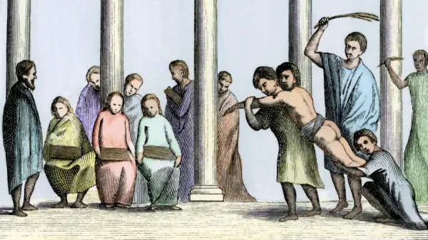
GCSE Latin Grammar:
The Tricky Bits
Dr Jessica Dixon
Head of Classics, Woldingham school
dixonj@woldinghamschool.co.uk

Slide 2
What are the tricky bits of Latin grammar?
What surprises us about what students find tricky?
Why are they tricky?
Passives – PPPs, perfect and pluperfect passive verbs
Subjunctives – recognising the verbs and translating clauses
Indirect Statement
Ablative absolute (OCR)
ad + gerundive (OCR)
Notes:
Comments shared by the group during the option group have been added in notes.
Other tricky areas of grammar:
Pronouns
Comparative adjectives
Accusative trap
Subordinate clauses
Connecting relatives
Reasons why students find them difficult:
Students don't want to learn anything.
Lack of correspondence between Latin and English.
Subjunctives are taught at the end.
They don't think through the different parts of a word.

Slide 3
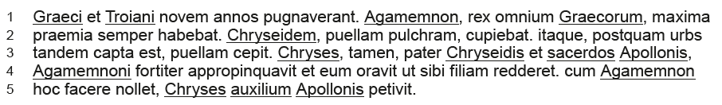
Metacognition: Self-questioning
What do I have to ask myself about this type of word?
  Verbs: meaning, person, mood, voice, tense
  Nouns: meaning, number, case
  Other words: adjectives, adverbs, prepositions, conjunctions
Where have I seen this before?
What would I expect to find connected to/following this word?
How does the punctation help me?
Notes:
Model thinking.
Practise to make the process automated.

Slide 4
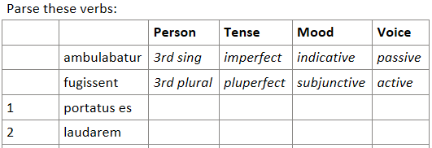
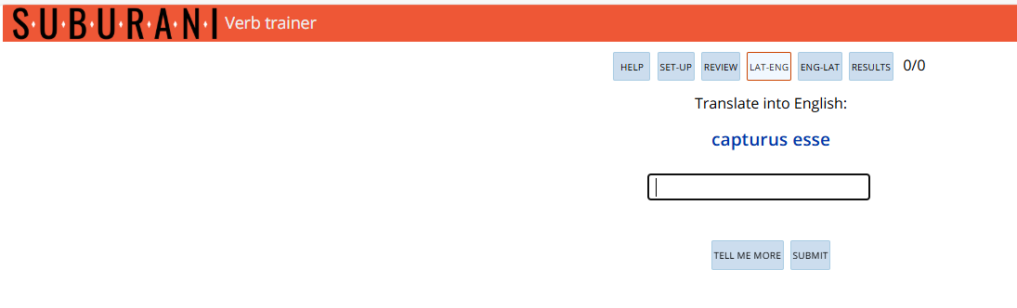
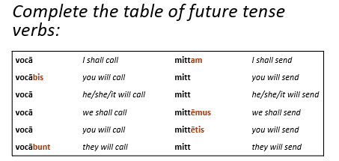
Verbs
Parsing exercises
Online testers
Recall tasks
Low stakes tests
Translation practice
Notes:
Other exercises:
They summarise and teach a topic to others
Translate verbs from an exam passage before doing the whole thing
Colour coding verbs and nouns etc.
Sentence builders
Stepped translations

Slide 5
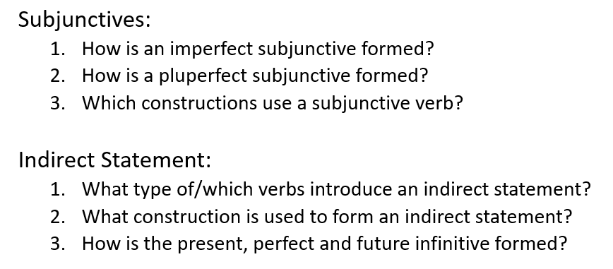
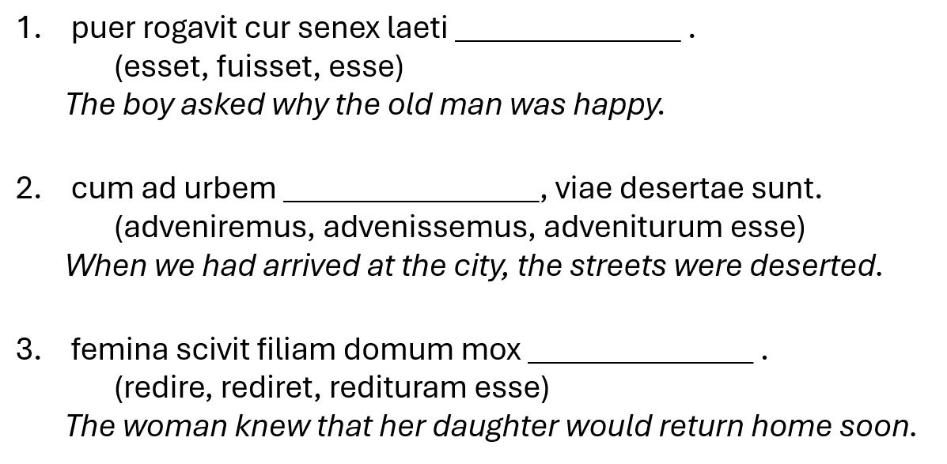
Constructions
Grammar quizzes at start and end of lesson
‘Challenges’ and games
Staged practice
  Focused sentences
  Mixed sentences
  Unseen passages
Scaffolded tasks
Model answers
Graphic organisers to lay out the rules

Slide 6
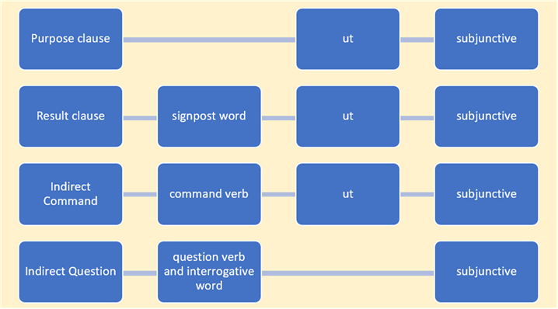
Graphic Organisers
Translate each sentence and state whether it contains a result clause, a purpose clause, an indirect command, or an indirect question.
fīlius nūllō modō mātrem cōgere poterat ut vestīmenta nova emeret.
tibi imperium ā nōbīs datum est ut nōs servārēs.
verba eius in tantam īram nōs mōverant ut bellum mox gererēmus.
eum rogāvistī cūr nēmō hunc hominem umquam anteā vīdisset.
equitēs tam celeriter prōgressī sunt ut multās fēminās vīvās caperent.
cīvēs eōs ōrābant nē equōs terrērent.

Slide 7
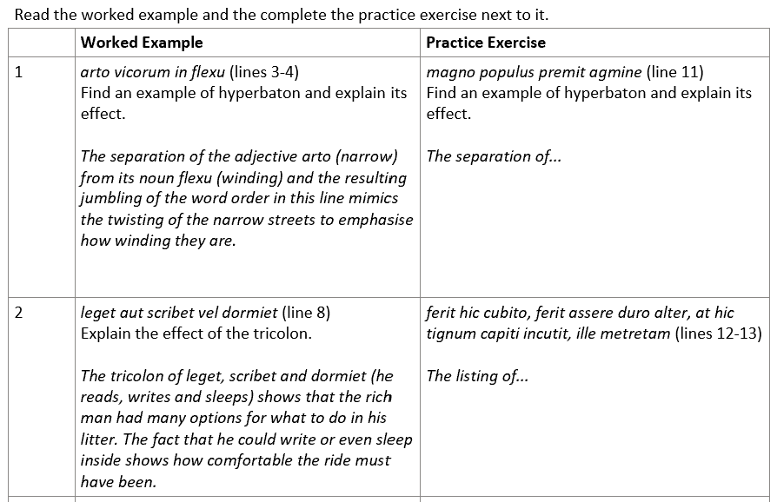
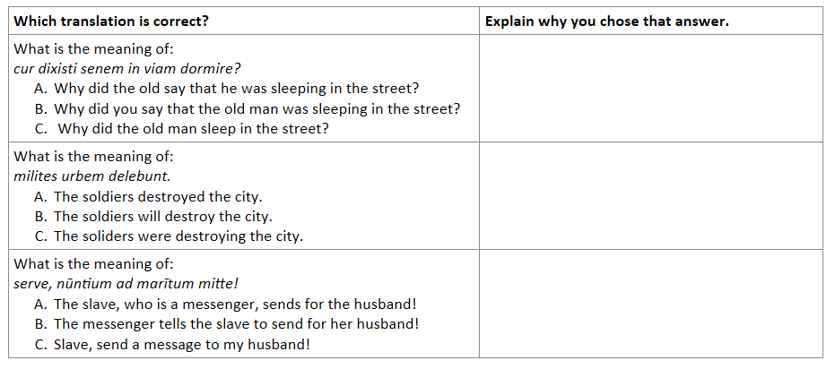
Scaffolded Tasks
Worked examples
Faded practice
Multiple-choice

Slide 8
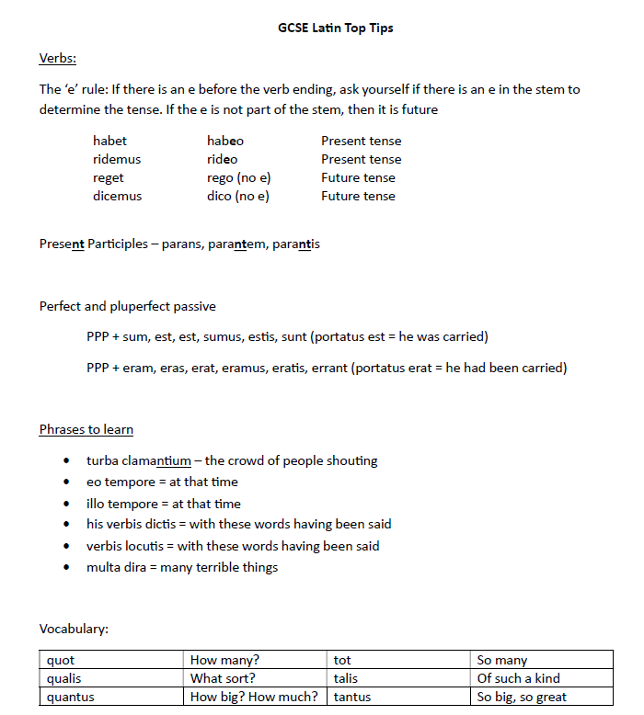
Top Tips
What are your top tips?
Notes:
Other top tips:
Rhymes, saying and gestures:
ior adds the meaning more
illi issi erri add the meaning very
tawabl and thlacc (‘time at when ablative’ and ‘time how long accusative’
Give them list of easily confused words
Use a picture to summarise prepositions

Slide 9
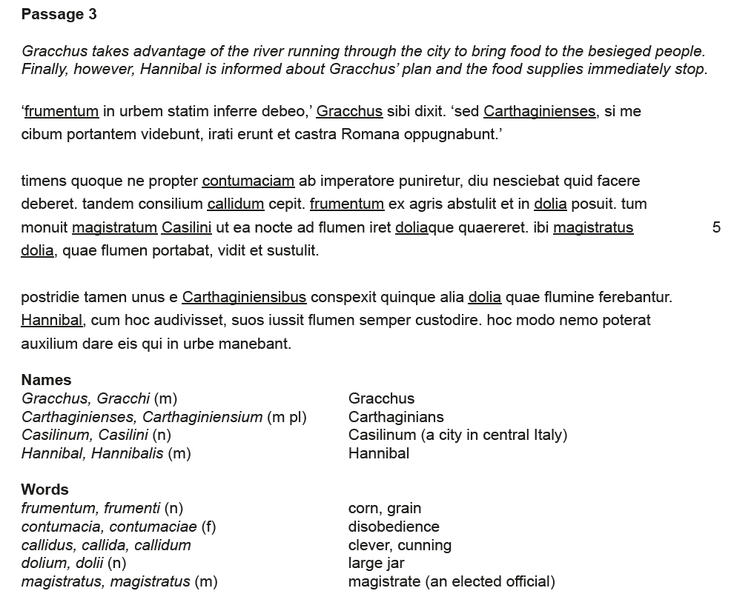
Resources

Slide 10

