Slide 1
Practical uses of AI in Latin and Classical Civilisation
Dimitrios Xerikos
St Bernard`s Catholic Grammar School

Slide 2
Why did I decide to talk about AI?
The use of AI is a big topic in education right now.
Governments in both the UK and the USA are planning to invest a lot of money in the development of AI in education.
At the beginning, I was a bit sceptical, but the feedback I received from other teachers was positive.

Slide 3
What am I going to do in this presentation?
I will talk about some ways in which I have used AI in teaching Latin and Classical Civilisation and why I thought it was successful.

Slide 4
Visual material
Why is the use of visual material effective in teaching Latin and Classical Civilisation?
Enhances understanding and retention
Engages and motivates the students
Encourages discussions and critical thinking

Slide 5
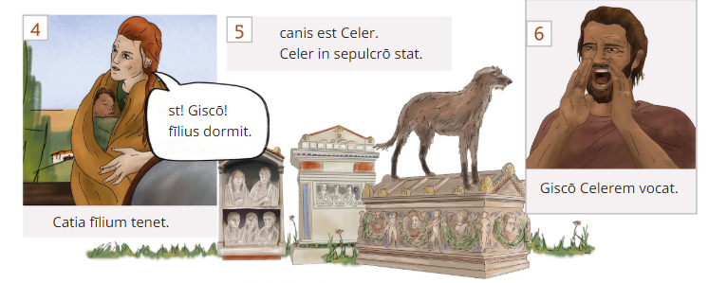
SUBURANI

Slide 6
Cambridge Latin Course

Slide 7
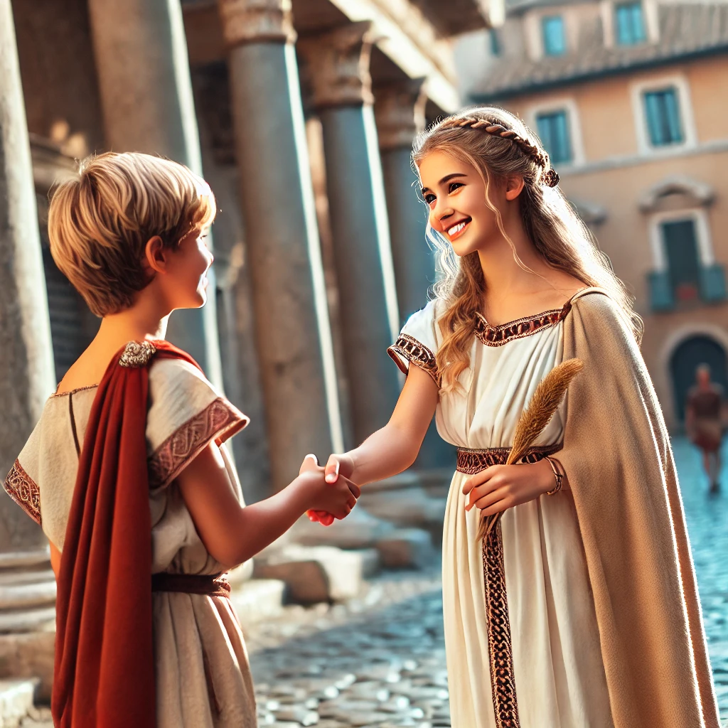
How can I create visual material using AI?
Please generate a photo which shows a Roman girl greeting a Roman boy
puella puerum salutat.

Slide 8
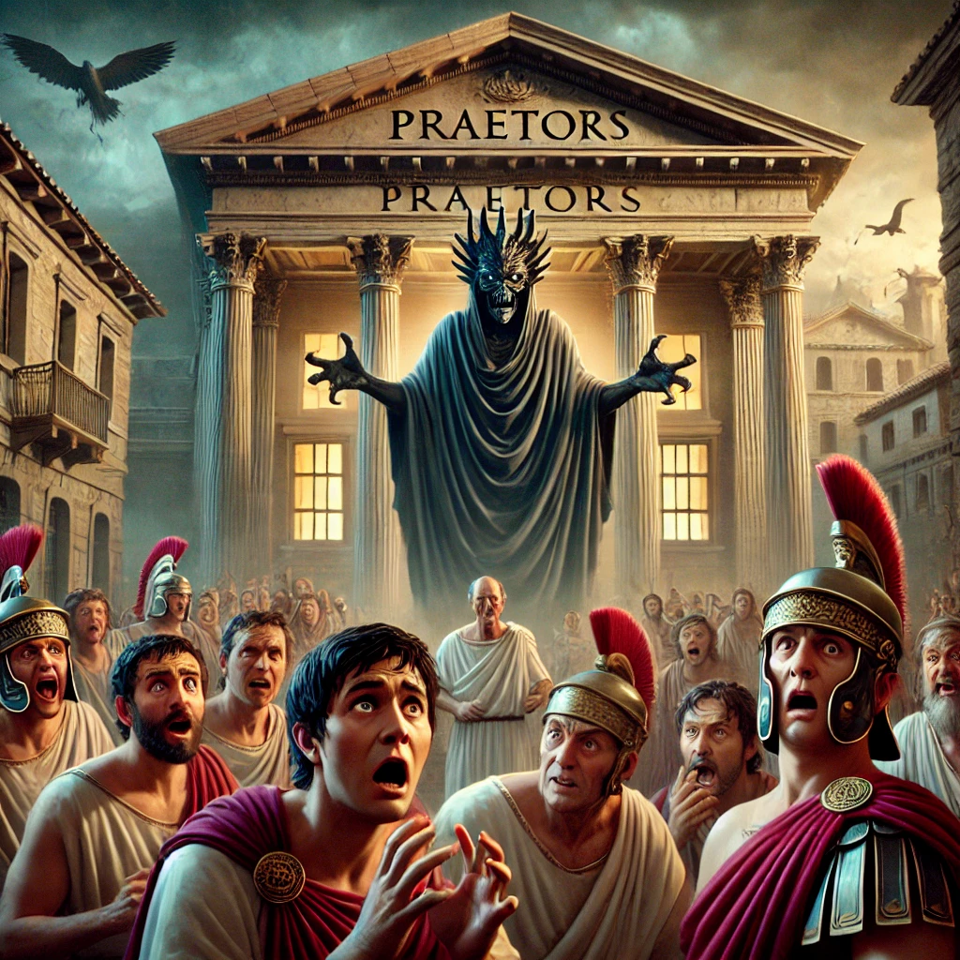
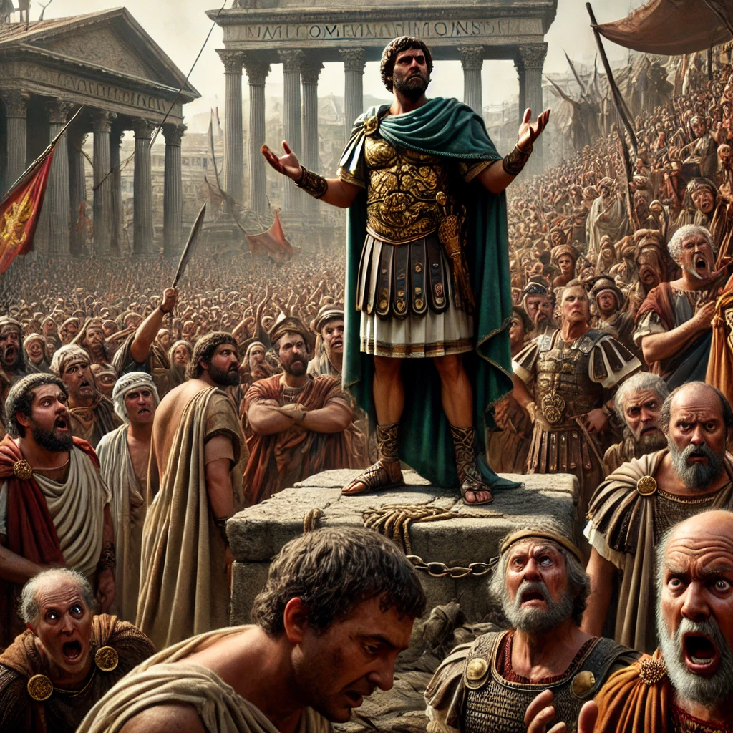
How are these photos related to the story? [Lines 25-35]

Slide 9
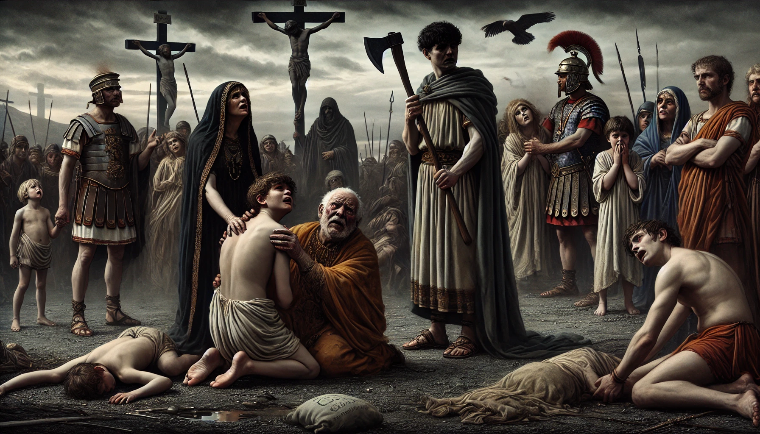

Slide 10
How can I use the photos generated by AI in Latin?
Display an image and ask students to say it in Latin.
Use images of people performing actions and ask students to describe them using Latin verbs in the correct tense.
Highlight specific grammatical structures in images, such as: Prepositions (e.g., puella prope templum stat—The girl stands near the temple).
Case Usage (e.g., hic vir gladium tenet—This man holds a sword).
Provide a Latin passage and ask students to match sentences to the correct images.
Compare an image of an insula with modern apartment buildings and discuss similarities and differences.

Slide 11
Stories
You can ask AI to create a story for you using the vocabulary you want your students to learn.

Slide 12
What kind of story?
Please create a story for Year 7 Latin students using the following vocabulary:
amita aunt
cella room
certē certainly, clearly
clāmōsa noisy, rowdy
dormiō (I) sleep, am sleeping
dormīs (you) sleep, are sleeping
ego I
es (you) are
est is, there is, it is
Faustus Faustus
fīlia daughter
frāter brother
habitō (I) live, am living
hercle oh no! oh dear!
hōra hour
in in, on
īnsula block of flats, apartment block
intrat (he, she) comes in, enters
labōrās (you) work, are working
labōrat (he, she) works, is working
labōrō (I) work, am working
legis (you) read, are reading
legit (he, she) reads, is reading
legō (I) read, am reading

Slide 13
Differentiation
Please create a simpler version of the following story for Year 7 Latin students: hōra octāva est. Subūra nōn est quiēta. Subūra est clāmōsa.
Faustus est in īnsulā. fīlia est in popīnā. Sabīna in popīnā labōrat.
servus est in viā. servus prō lectīcā ambulat. iuvenis est in lectīcā.
iuvenis est Lūcīlius. mendīcus est in viā. mendīcus est Mānius.
Mānius salvē! ego sum mendīcus!
servus tū nōbīs obstās!
Sabīna ē popīnā exit.
Sabīna Mānius est senex!
Lūcīlius ē lectīcā exit. hercle! tēgula cadit.
Sabīna cavē!
tēgula in viā cadit. Lūcīlius est perterritus.
Sabīna Subūra est perīculōsa! certē tū in Subūrā nōn habitās.
Lūcīlius ērubēscit. Sabīna rīdet. Mānius nōn rīdet.

Slide 14
Scaffolding
Please provide scaffolding for the following story for Year 7 Latin students: hōra octāva est. Subūra nōn est quiēta. Subūra est clāmōsa.
Faustus est in īnsulā. fīlia est in popīnā. Sabīna in popīnā labōrat.
servus est in viā. servus prō lectīcā ambulat. iuvenis est in lectīcā.
iuvenis est Lūcīlius. mendīcus est in viā. mendīcus est Mānius.
Mānius salvē! ego sum mendīcus!
servus tū nōbīs obstās!
Sabīna ē popīnā exit.
Sabīna Mānius est senex!
Lūcīlius ē lectīcā exit. hercle! tēgula cadit.
Sabīna cavē!
tēgula in viā cadit. Lūcīlius est perterritus.
Sabīna Subūra est perīculōsa! certē tū in Subūrā nōn habitās.
Lūcīlius ērubēscit. Sabīna rīdet. Mānius nōn rīdet.

Slide 15
Creating comprehension questions
Please write questions on the following story for Year 7 students: hōra octāva est. Subūra nōn est quiēta. Subūra est clāmōsa.
Faustus est in īnsulā. fīlia est in popīnā. Sabīna in popīnā labōrat.
servus est in viā. servus prō lectīcā ambulat. iuvenis est in lectīcā.
iuvenis est Lūcīlius. mendīcus est in viā. mendīcus est Mānius.
Mānius salvē! ego sum mendīcus!
servus tū nōbīs obstās!
Sabīna ē popīnā exit.
Sabīna Mānius est senex!
Lūcīlius ē lectīcā exit. hercle! tēgula cadit.
Sabīna cavē!
tēgula in viā cadit. Lūcīlius est perterritus.
Sabīna Subūra est perīculōsa! certē tū in Subūrā nōn habitās.
Lūcīlius ērubēscit. Sabīna rīdet. Mānius nōn rīdet.

Slide 16
AI can generate scripts
AI can generate basic dialogues for students to read aloud or act out.
AI create Latin conversations for different scenarios (e.g., shopping in the forum, visiting the baths)

Slide 17
Creating grammar activities
Please create Latin sentences for my Year 7 students to practise the present tense using the following vocabulary:
amita aunt
cella room
certē certainly, clearly
clāmōsa noisy, rowdy
dormiō (I) sleep, am sleeping
dormīs (you) sleep, are sleeping
ego I
es (you) are
est is, there is, it is
Faustus Faustus
fīlia daughter
frāter brother
habitō (I) live, am living
hercle oh no! oh dear!
hōra hour
in in, on
īnsula block of flats, apartment block
intrat (he, she) comes in, enters
labōrās (you) work, are working
labōrat (he, she) works, is working
labōrō (I) work, am working
legis (you) read, are reading
legit (he, she) reads, is reading
legō (I) read, am reading

Slide 18
Using AI to create exam style questions for GCSE and A-Level Latin and Classical Civilisation
Imagine that you are the emperor in Rome and you want to put on some entertainment.
Do you choose to put on shows at the Colosseum or races at the Circus Maximus?
Give reasons for your answer.
In your answer:
• you should include references to a range of ancient sources;
• you may make use of Sources D, E and F;
• you may wish to include references to other amphitheatres or stadiums. [12]
Please create an exam question similar to the one above on Roman entertainment. Students need to be familiar with the Circus Maximus, chariot racing, dinner parties, and the theatre at Pompeii.

Slide 19
Using AI to create questions on videos
Please create questions based on the following transcript.
https://www.youtube.com/watch?v=ETd7pszxhnc

Slide 20
Create scripts and dramatic narratives of texts you teach for A-Level Classical Civilisation
BkI:44-95 Athene seeks help for Odysseus.
The bright-eyed goddess, answered him at once: ‘Father of us all, Son of Cronos, Highest King, clearly that man deserved to be destroyed: so let all be destroyed who act as he did. But my heart aches for Odysseus, wise but ill fated, who suffers far from his friends on an island deep in the sea. The island is densely wooded and a goddess lives there, a child of malevolent Atlas, he who knows the depths of the sea, and supports the great columns that separate earth and sky. It is his daughter who detains that unlucky, sorrowful man: she lulls him, always, with soft seductive words, intending him to forget Ithaca. But Odysseus, who yearns for the mere sight of the smoke rising from his own country, only longs to die. Yet, Olympian, your heart is unmoved. Did he win no favour with the sacrifices he made you, by the Argive ships, on the wide plains of Troy? Why do you will this man such pain, Zeus?’ Cloud-Gathering Zeus answered her then: ‘My child, what words escape your lips? How could I ever forget godlike Odysseus, who exceeds all mortals in wisdom, and also in sacrifice to the deathless gods who inhabit the broad heavens? It is Poseidon, the Earth-Bearer, who is always filled with implacable anger against him, because of godlike Polyphemus, the strongest Cyclops of all, whom Odysseus blinded. The nymph Thoosa bore him, daughter of Phorcys who rules the barren sea: she slept with Poseidon in the hollow caves. Since that blinding, Poseidon, the Earth-Shaker, though he will not kill him, keeps Odysseus far from his native land. Come, let all here plan how he might come home: then Poseidon will relent, since he’ll not be able to contend, alone, against all the deathless gods together.’ The goddess, bright-eyed Athene, answered him: ‘Father of us all, Son of Cronos, Highest King, if it truly pleases the blessed gods for wise Odysseus to return home, let us send Hermes, the Messenger, Slayer of Argus, to the isle of Ogygia, so he can tell the Nymph with the lovely tresses of our unalterable decision, that long-suffering Odysseus may come home. Meanwhile I will go to Ithaca, to stir his son, and encourage him to call the long-haired Achaeans together, and speak his mind to the Suitors who slaughter his flocks of sheep, and his shambling cattle with twisted horns. Then I will lead him to Sparta and sandy Pylos to gain news of his loyal father’s return, if he can, and so win praise.’

Slide 21
Create scripts and dramatic narratives of texts you teach for A-Level Classical Civilisation
Please turn the following text into a script.
Please turn the following into a dramatic narrative.

Slide 22
Storyboards for A-Level Classical Civilisation
Create a story board using the following passage.

Slide 23
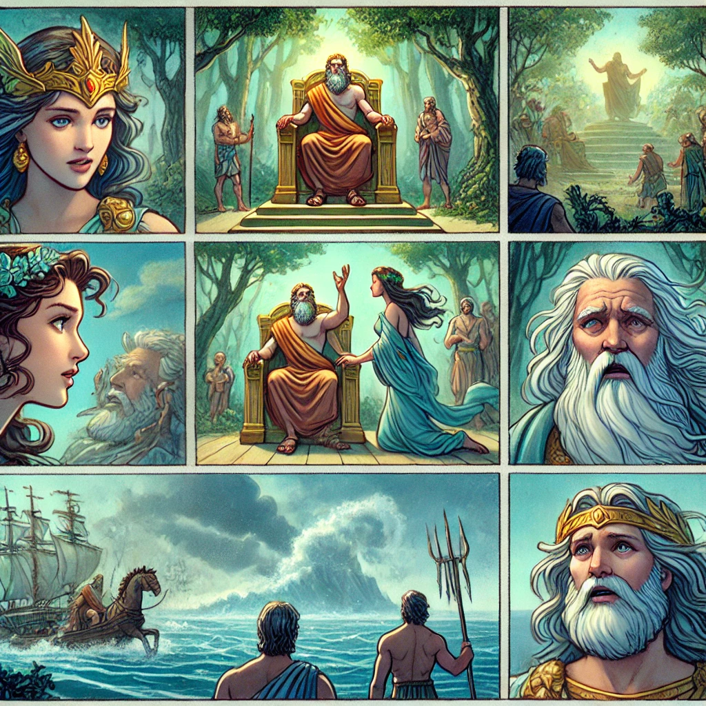

Slide 24
Some final thoughts on the use of AI
AI can save us time by creating a variety of tasks and activities for our students
AI should be seen as a personal assistant
We should be careful when we use AI and never give any personal information, such as student names
We should always follow the school policy in terms of using AI
We always need to check all the tasks and activities before we give them to our students. AI makes mistakes
Teacher input is crucial

