Slide 1

Achieving Level 5 in A Level Classical Civilisation
Dr Jessica Dixon
Head of Classics Woldingham School
dixonj@woldinghamschool.co.uk

Slide 2
The Plan…
What are the expectations?
What does and does not achieve level 5?
How can we support students to do this in the exam?

Slide 3
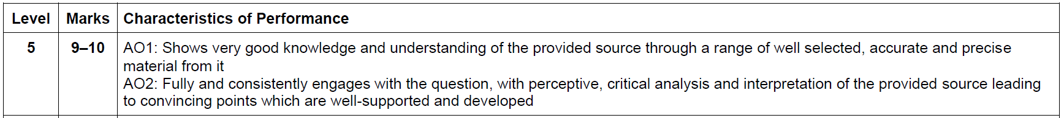
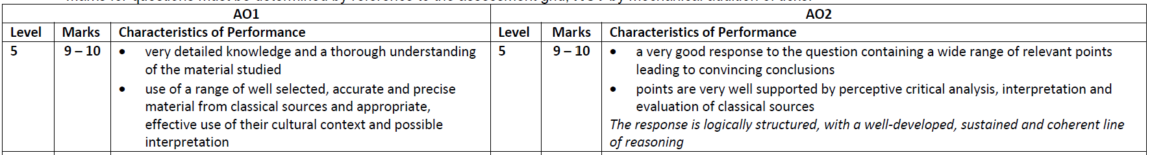
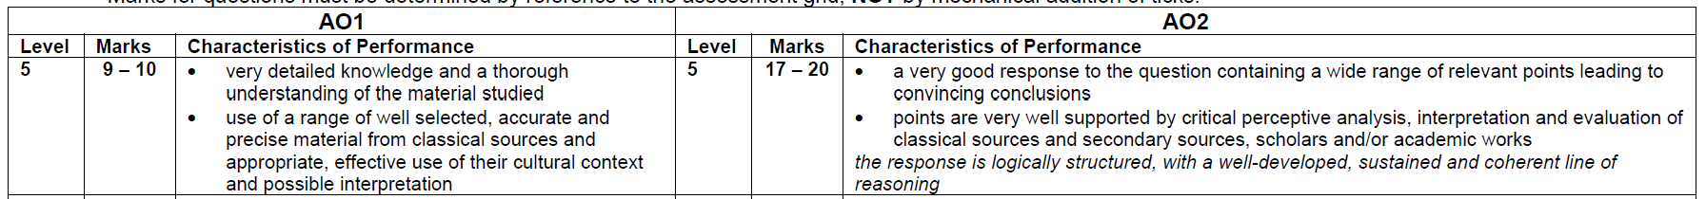
What are the expectations?
10-mark Questions
20-mark Questions
30-mark Questions
Quality of response determines the level and then the 2nd bullet point which includes use of secondary scholarship determines what mark in that level is awarded.

Slide 4
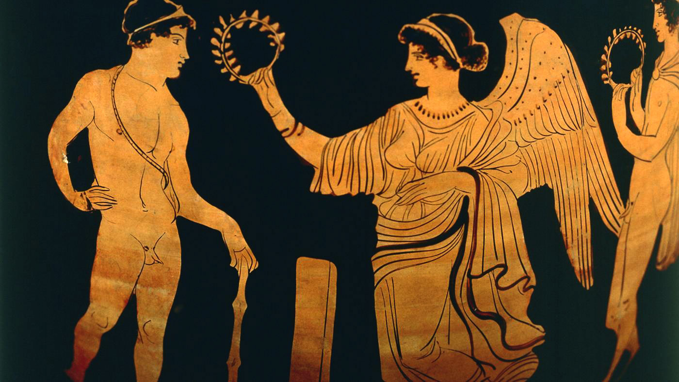
Advice from the examiners:
The most successful candidates have:
Legible writing and clear layout (paragraphs, etc.)
Very detailed and accurate reference to the sources
Answered the question set
A well-reasoned, concise argument
Sustained a clear line of reasoning
Organised their response into themes based on distinct points
Acknowledged social/historical context
Timed their exam well to answer all questions fully
Given nuanced and precise analysis and evaluation (e.g., explaining how something was good leadership)
Only included relevant material
Addressed the key issues but included a wide range of material and ideas
Integrated secondary scholarship into the discussion and engaged with their views

Slide 5
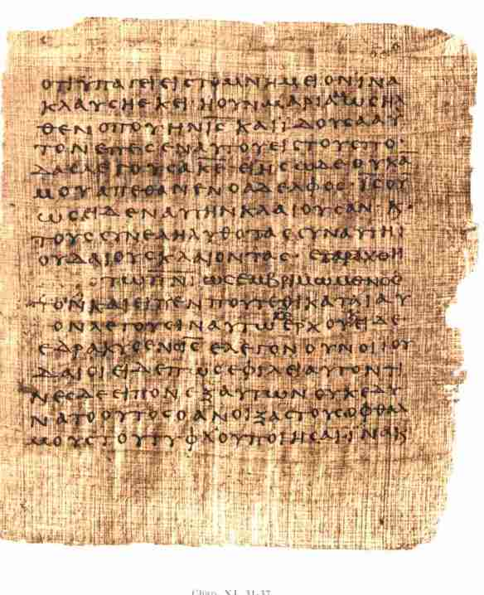
What does and does not achieve level 5?
What did the answers who achieved level 5 do well?
What else did those who achieved level 4 need to do to get level 5?
Please email me if you’d like a copy of all the marked scripts.

Slide 6
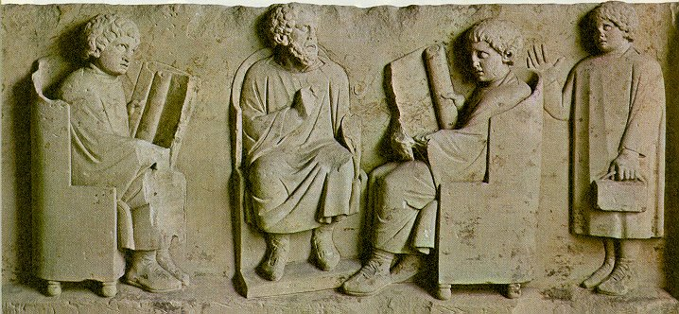
Teaching Strategies to achieve this
Model answers
Scaffolded tasks to developed analysis and their line of reasoning
Improving example level 4 answers
Retrieval practice
Flipped learning
Timed exam practice
Feedback tasks to improve on written work

Slide 7
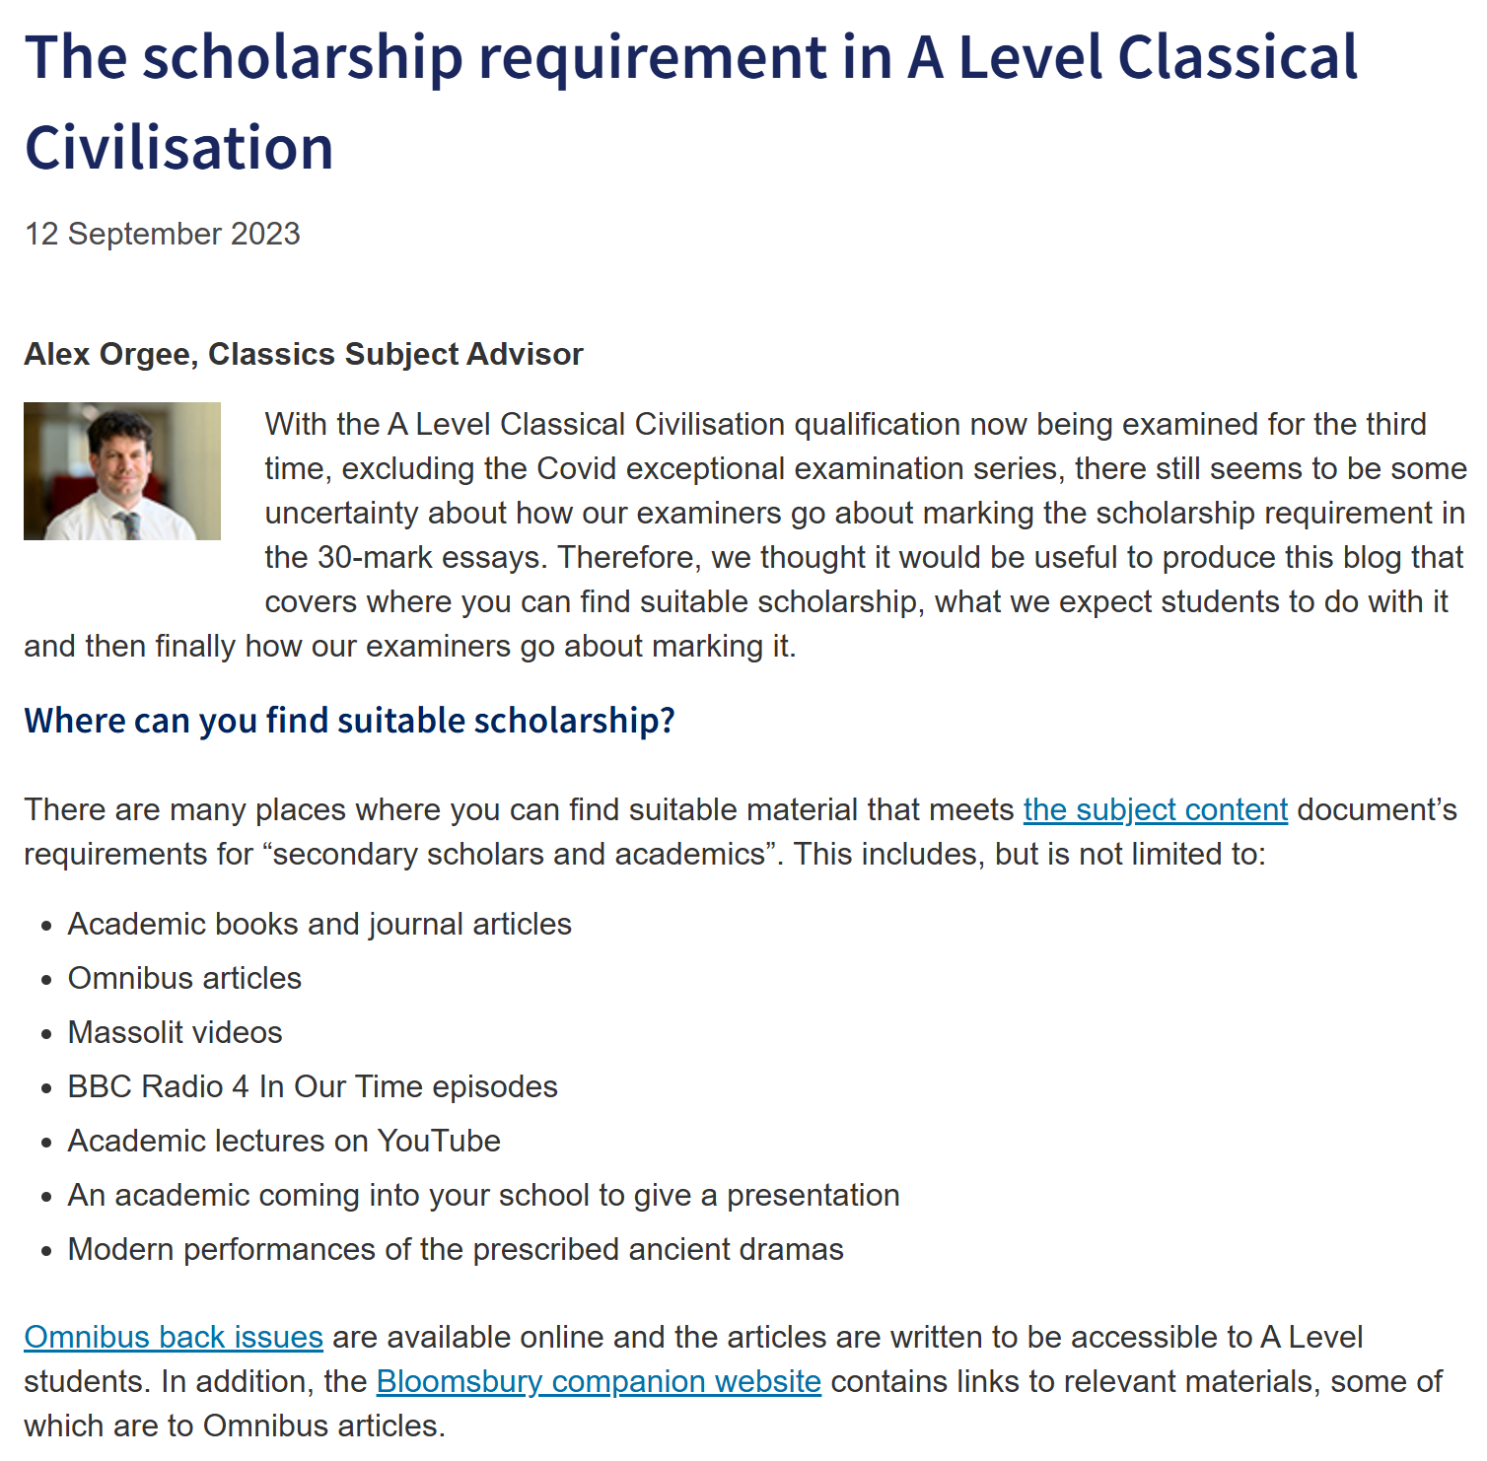
Secondary Scholarship
Use of secondary scholarship is not going to determine their level
But we still need to develop:
  Secondary scholarship recall
  Integration of scholarship into answers
What are your suggested teaching strategies?
The scholarship requirement in A Level Classical Civilisation
https://www.ocr.org.uk/blog/the-scholarship-requirement-in-alevel-classical-civilisation/

Slide 8

Questions?
dixonj@woldinghamschool.co.uk

