Slide 1
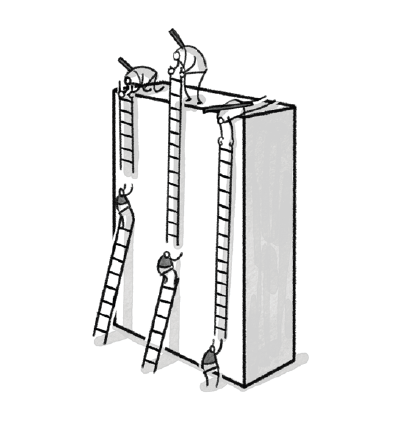

Adaptive Teaching in Latin and Classics for classes with varying and additional needs
Lottie Mortimer
Latin & Classics PGCE Co-Lead, University of Sussex
lm672@sussex.ac.uk
@MissCMort

Slide 2

TASK: Introduce yourself
Name
A little about your context
Why you chose this option group and what you want to get out of it.
quis es?

Slide 3
The current plan:
However, this is your option group.
We can put more or less emphasis on different areas to make it work for you.
What is ‘adaptive teaching’?
How is it different from ‘differentiation’?
What ideas are out there on adaptive teaching?
Latin
Civilisation
Mixed attainment 9-1
SEND
Literacy
EAL
❗I don’t have all the answers ❗
This is an area of my practice I still wish to improve.
Please share throughout our sessions.

Slide 4
Differing and Varying Needs
Mixed attainment 9-1 classroom
SEND
(Special Educational Needs and Disabilities)
Low levels of literacy
EAL
(English as an Additional Language)

Slide 5
Remember: every child is a unique individual.
Labels can be useful.
The best way to adapt your teaching is to know the pupils that you teach.

Slide 6

Does our subject disadvantage subjects with differing and varying needs?
Latin “is considerably more difficult than most of the other subjects in almost the entire ability range” and that “GCSE Latin is over two grades harder than the easiest subjects at lower grades.”
He, Stockford & Meadows (2018)
Qingping He, Ian Stockford & Michelle Meadows (2018) Inter-subject comparability of examination standards in GCSE and GCE in England, Oxford Review of Education, 44:4, 494-513, DOI: 10.1080/03054985.2018.1430562

Slide 7
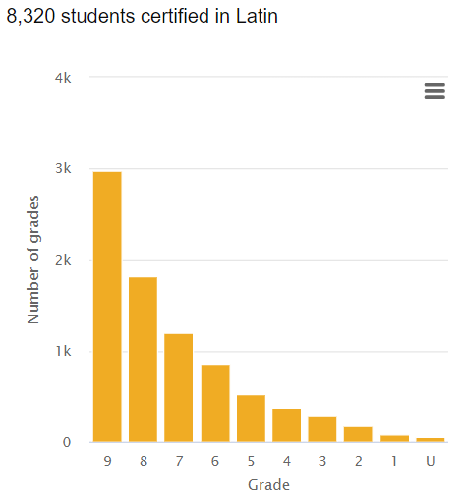
Does our exams let our students show what they know?
59.3% of students sitting the Latin GCSE in 2023 were awarded grades 8 or 9 (GCSE French nationally 15.4% of all candidates were awarded grades 8 or 9 and in Spanish 14.7%)
Latin is examined as an all through paper without a foundation tier.
Although the exam is designed as a momentum test (the level of challenge is intended to increase as the test goes on), the exams in 2018 and 2019 examination series still put difficult linguistic features (such as deponent verbs and subjunctive constructions) near the beginning of texts.
https://analytics.ofqual.gov.uk/apps/GCSE/9to1/

Slide 8
Where does “adaptive teaching” appear in policy??

Slide 9

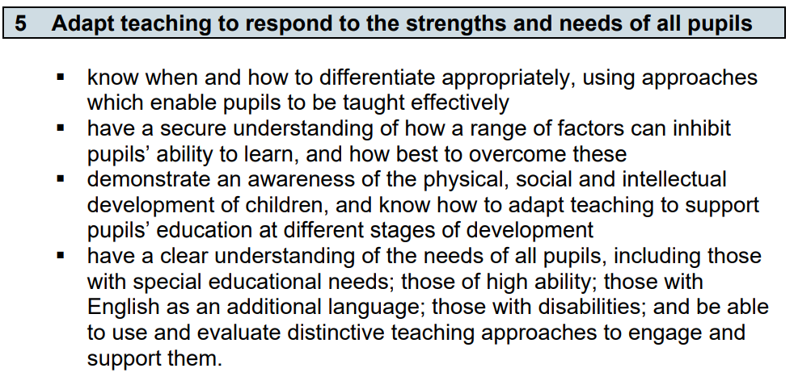
AT is part of your role as a teacher

Slide 10

The SEND Code of Practice (2015)
6.36 Teachers are responsible and accountable for the progress and development of the pupils in their class, including where pupils access support from teaching assistants or specialist staff.
6.37 High quality teaching, differentiated for individual pupils, is the first step in responding to pupils who have or may have SEN. Additional intervention and support cannot compensate for a lack of good quality teaching. Schools should regularly and carefully review the quality of teaching for all pupils, including those at risk of underachievement. This includes reviewing and, where necessary, improving, teachers’ understanding of strategies to identify and support vulnerable pupils and their knowledge of the SEN most frequently encountered.
Notes:
https://assets.publishing.service.gov.uk/media/5a7dcb85ed915d2ac884d995/SEND_Code_of_Practice_January_2015.pdf

Slide 11

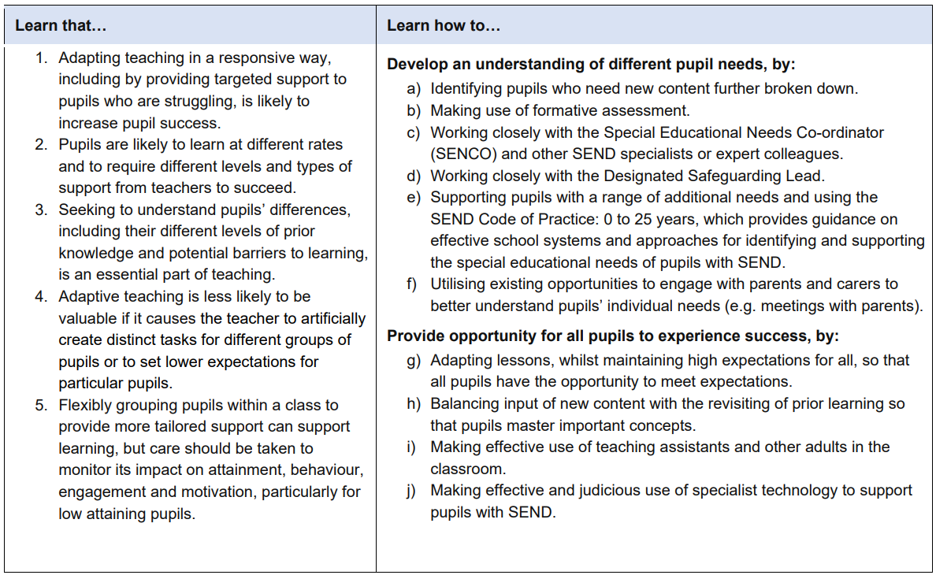
The ITTECF (2024)
Notes:
https://assets.publishing.service.gov.uk/media/661d24ac08c3be25cfbd3e61/Initial_Teacher_Training_and_Early_Career_Framework.pdf

Slide 12
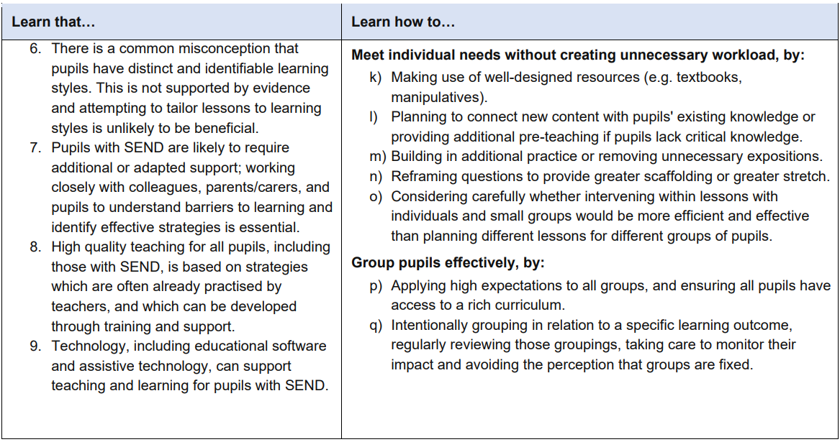
The ITTECF (2024)
Notes:
https://assets.publishing.service.gov.uk/media/661d24ac08c3be25cfbd3e61/Initial_Teacher_Training_and_Early_Career_Framework.pdf

Slide 13

OFSTED Grade Descriptors for Quality of Education
2014 School Inspection Handbook
Teachers use well-judged and often imaginative teaching strategies, including setting appropriate homework that, together with clearly directed and timely support and intervention, match individual needs accurately. Consequently, pupils learn exceptionally well across the curriculum.
2024 School Inspection Handbook
Teachers present subject matter clearly, promoting appropriate discussion about the subject matter being taught. They check pupils’ understanding systematically, identify misconceptions accurately and provide clear, direct feedback. In so doing, they respond and adapt their teaching as necessary without unnecessarily elaborate or individualised approaches.

Slide 14
What was the problem with ‘differentiation’?
Differentiation: tailoring teaching to meet the individual needs of each student.
Adaptive Teaching: adapt teaching to respond to the strengths and needs of all pupils

Slide 15
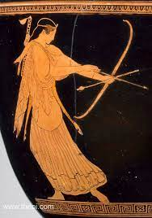
Today’s aims:
ALL: define adaptive teaching
MOST: explain why it is important to adapt out reaching our lessons
SOME: start to implement adaptive teaching into our lesson planning.

Slide 16
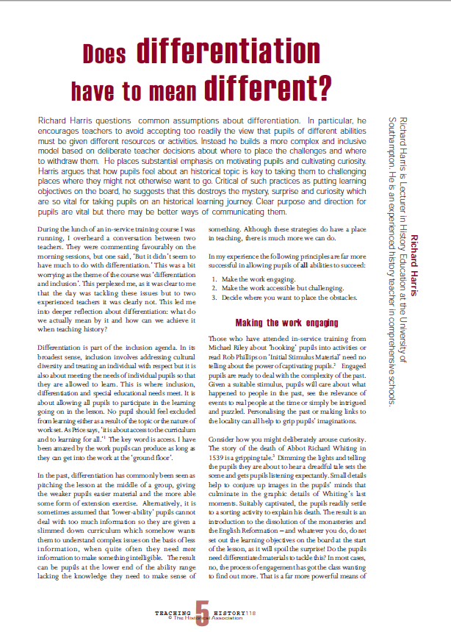
“In the past, differentiation has commonly been seen as pitching the lesson at the middle of the group, giving the weaker pupils easier material and the more able some form of extension exercise.”
“It is sometimes assumed that ‘lower ability’ pupils cannot deal with too much information so they are given a slimmed down curriculum which somehow wants them to understand complex issues on the basis of less information, when quite often they need more information to make something intelligible.”
Harris, R. (2005) Does differentiation have to mean different? Teaching History

Slide 17
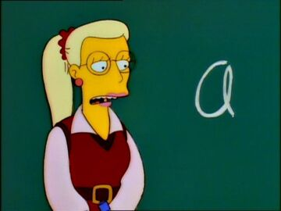
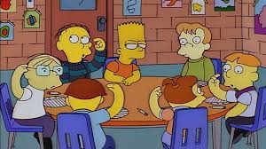
Let me get this straight, we’re behind the other kids and we’re going to catch them up by going slower than them?

Slide 18
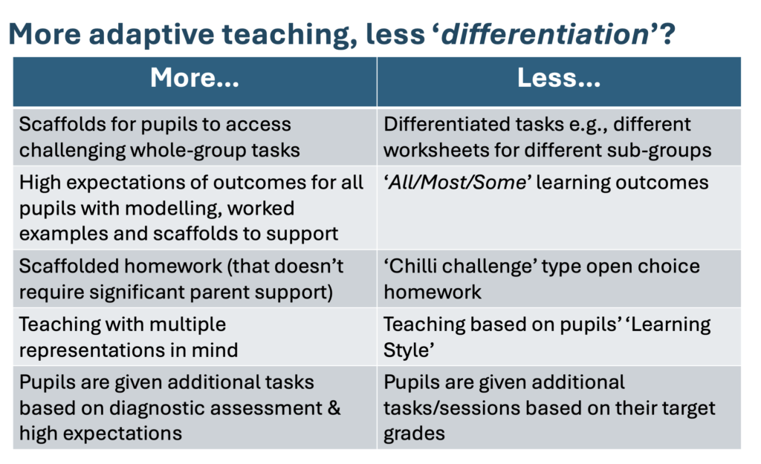
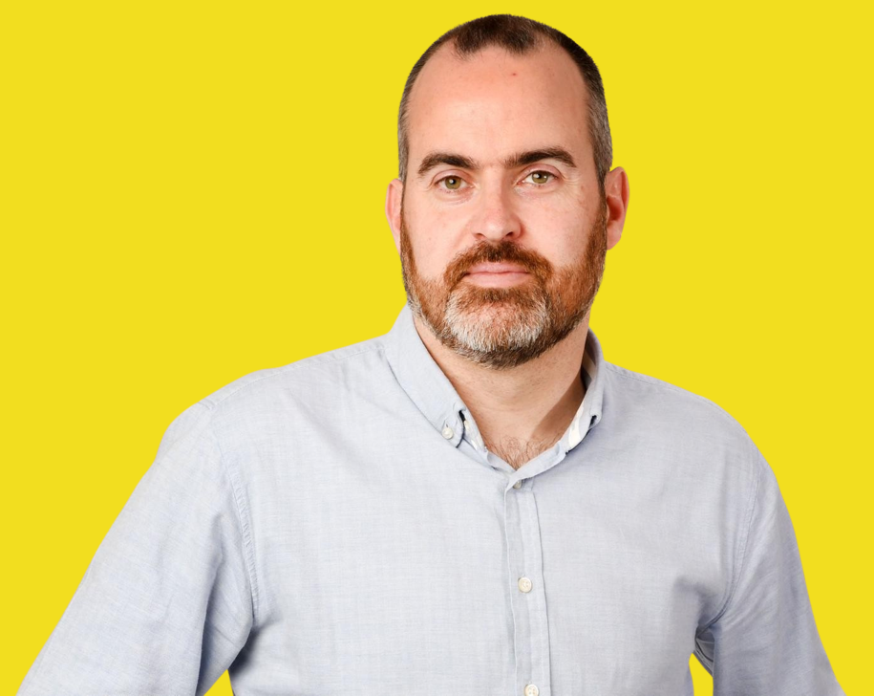
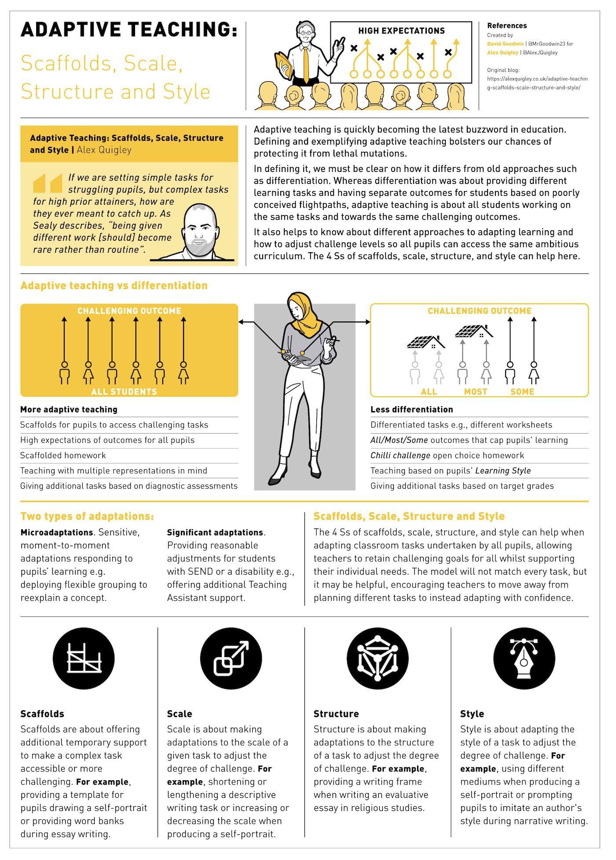
Alex Quigley
https://alexquigley.co.uk/adaptive-teaching-scaffolds-scale-structure-and-style/

Slide 19

Ashbee’s restaurant analogy – quality first teaching
There’s an outbreak of E. coli at a restaurant.
The local hospital reports patients being treated for the bug fall into two ‘key groups’: babies and the elderly
Options the restaurant is considering:
  collect data when orders are taken and to cook the food for twice as long as normal for those customers who are over the age of 65.
  preparing food for babies using specially sterilised utensils
What needs to happen - sort out the hygiene in its whole operation. It doesn’t need to change what it does for the key groups. It needs to change what it is doing at its core.
Ruth Ashbee https://www.ruth-ashbee.com/post/e-coli-and-quality-first-teaching

Slide 20
Quigley’s two types of adaptations:
Microadaptations (Corno, 2008) | Significant adaptations
Sensitive, moment-to-moment adaptations responding to pupils’ learning e.g. deploying flexible grouping in a history lesson to quickly reexplain how they might more effectively plan their essay on Scrooge. | Pupils with a learning difficulty or disability may require significant adaptations and schools are required to ensure reasonable adjustments are made e.g., offering additional Teaching Assistant support with complex tasks. (These can be concurrently described as ‘reasonable adjustments’ when supporting pupils with SEND).
Alex Quigley
https://alexquigley.co.uk/adaptive-teaching-scaffolds-scale-structure-and-style/

Slide 21
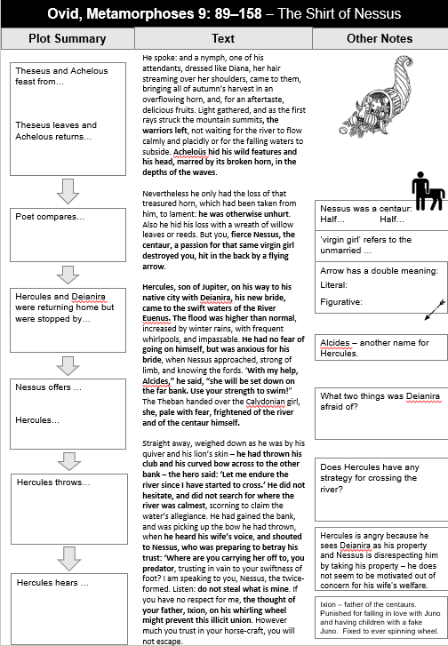
An example from my own teaching
Year 10 Classical Civilisation
Myth & Religion
The Universal Hero – Heracles
Pupil with visual impairment struggling to make annotations.
Created framework for annotation – everyone in the class benefitted and we could then spend more time discussing the text.

Slide 22
How do I adapt my teaching to respond to the strengths and needs of all pupils?

Slide 23
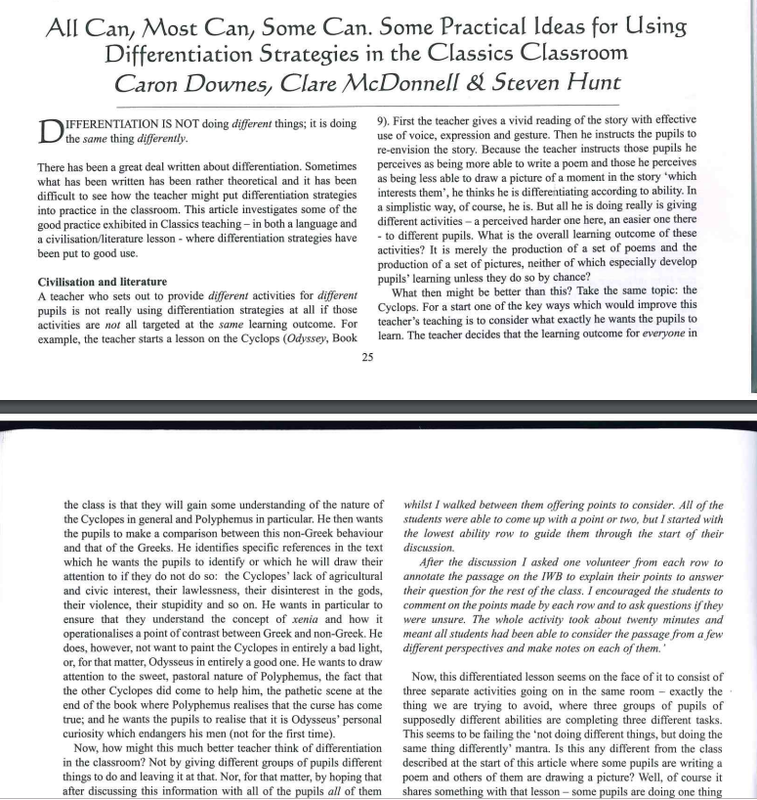
‘There has been a great deal written about differentiation. Sometimes what has been written has been rather theoretical and it has been difficult to see how the teacher might put differentiation strategies into practice in the classroom.’
Downes, McDonnell & Hunt. (2012) JCT
https://www.theclassicslibrary.com/JACT/Downes,%20C.,%20McDonnell,%20C.%20and%20Hunt,%20S.%20(2012).%20All%20can,%20most%20can,%20some%20can.%20Some%20practical%20ideas%20for%20using%20differentiation%20strategies%20in%20the%20Classics%20classroom.%20JCT%2026,%2025-27.pdf

Slide 24

Hunt (2023) – 8 ways to differentiate
“differentiation is not about the students doing different things, it is about doing the same thing differently.”
By Outcome
By Product
By Input
all given same resources & activity but will work at own level and achieve different levels of outcome. Focussed on final product not learning process.
sets same task but pupils respond in different ways. Choice or teacher allocation of task.
teacher provides different resources to help students achieve the same task.
By Questioning
teacher adapts question type to needs of student.
By Intervention
in class teacher realises pupils need different approach and modifies task/approach during lesson.
By Progressive Questioning
ask straightforward questions to lower attaining pupils and build in responses by asking more challenging questions to higher attaining pupils. Momentum task on worksheet.
By Grouping
group pupils according to prior attainment.
By Task
pupils given different tasks to complete.

Slide 25

Sealey’s 4 verbs of adaptive teaching:
Challenge Variables | How to adapt by increasing or decreasing challenge
Having to think about more things | Adapting the number of things learners have to think about (reduce)
The intrinsic demands of the content | Planning a curriculum that reinforces and builds on previous knowledge: connecting new learning to previously learned content and preparing for and improving access to future learning (anticipate)
How much external support for memory demands is provided | Providing support for memory demands (support)
How much the learner knows | Ensure learners know enough to access the lessons AND have a robust culture of retrieval so knowledge is remembered long term (strengthen)
“being given different work [should] become rare rather than routine”
Clare Sealy
https://primarytimery.com/2024/03/29/adaptive-teaching-the-four-verbs-approach/

Slide 26
Quigley’s 4 Ss of adaptive teaching:
Scaffolds
Scale
Structure
Style
Offering additional temporary support to make a complex task accessible or more challenging.
Making adaptations to the scale of a given task to adjust the degree of challenge
Making adaptations to the structure of a task to adjust for the degree of challenge
Adapting the style of a task to adjust the degree of challenge
E.g. providing a word bank during essay writing
E.g. increasing or decreasing a writing task
E.g. providing a writing frame for an evaluative essay
E.g. write from the perspective of a particular author
Alex Quigley
https://alexquigley.co.uk/adaptive-teaching-scaffolds-scale-structure-and-style/

Slide 27
In my experience the following principles are far more successful in allowing pupils of all abilities to succeed:
Make the work engaging
Make the work challenging but accessible
Decide where to put the obstacles in
Harris, R. (2005) Does differentiation have to mean different?

Slide 28
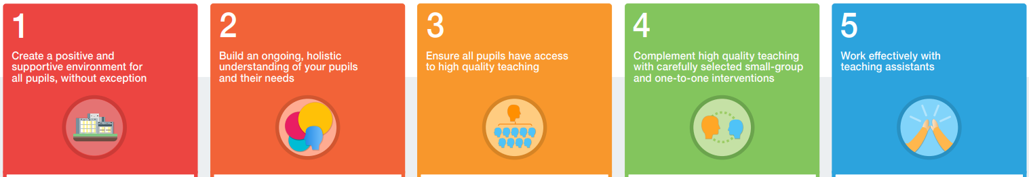
EEF – SEN in mainstream schools recommendations
To a great extent, good teaching for pupils with SEND is good teaching for all.
Searching for a ‘magic bullet’ can distract teachers from the powerful strategies they often already possess.
The research suggests a group of teaching strategies that teachers should consider emphasising for pupils with SEND. Teachers should develop a repertoire of these strategies they can use flexibly in response to the needs of all pupils.
flexible grouping;
cognitive and metacognitive strategies;
explicit instruction;
using technology to support pupils with SEND;
scaffolding.
https://educationendowmentfoundation.org.uk/education-evidence/guidance-reports/send

Slide 29
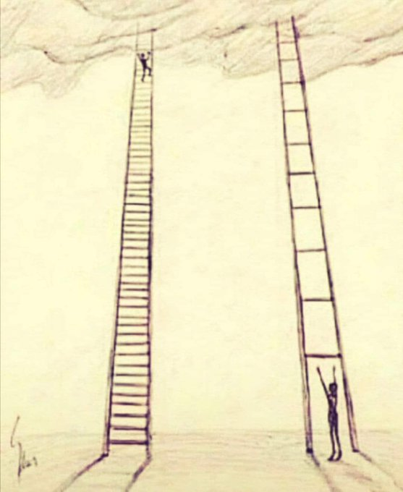
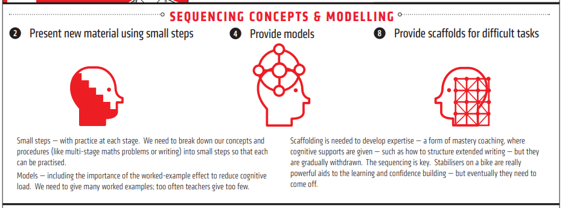
If we make our work more accessible – everyone in the class benefits!
Rosenshine’s recommendations:
Present new material in small steps.
Provide scaffold for difficult tasks
Provide models
Guide student practice
Notes:
https://static1.squarespace.com/static/58e151c946c3c418501c2f88/t/5bcad7810d929703affe7abb/1540020098430/Rosenshine+Principles+red.pdf

Slide 30

Adaptive teaching is a process:
Starting point: What do you want your students to learn?
What are the barriers to that learning?
What supports do students need to be able to access the learning?
Have you shown (modelled) students a worked example, narrating the process?
Where are you going to put the challenge?

Slide 31
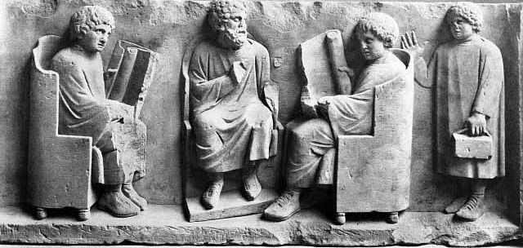
That’s great, but what subject specific strategies can I use in my classroom?
A subject specific reading list can be found here: https://www.stevenhuntclassics.com/sen

Slide 32

Dyslexia Scotland (2013)
Each section structured:
  Significant strengths
  Barriers to learning
  Additional support strategies
Over 10 years old now – some sections feel quite dated
http://training.cpdbytes.com/ResourceFiles/All/2_12TheClassics.pdf

Slide 33
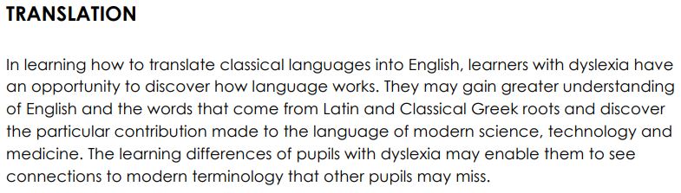
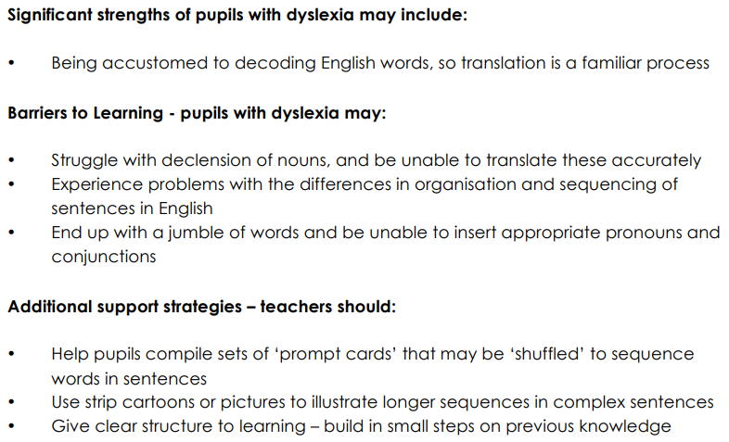

Slide 34
What might our students with additional and varying needs find difficult about translation?
Dyslexia & ADHD – one huge chunk of text.
Motivation – high attainers finish quickly whilst lower attainers still at the beginning
Differing and Varying Needs
Mixed attainment 9-1 classroom
SEND
(Special Educational Needs and Disabilities)
Low levels of literacy
EAL
(English as an Additional Language)
Autism – often there isn’t one correct translation
Not having the sufficient English vocabulary or grammar
Not having the sufficient English vocabulary or grammar

Slide 35
Translation
Break the text into smaller chunks – new sentences on different lines.
Read the story aloud – do the voices and actions for emphasis
What do you want your students to learn? Where should the focus be?
  Gap fill – choose carefully where to put the gaps. (Could indicate in bold the Latin which applies to the gap)
  Letter prompts
  Numbered translation
  Multiple choice translation
  Add images to support the text (keep images consistent)
Modelling & metacognition – talk students through the process
Pre teach key vocabulary through images
Pre-reading – get students to skim read the story beforehand and give them the vocabulary that they don’t know

Slide 36
Translation
Do students have enough contextual knowledge to understand the story?
Regular checkpoints to check for understanding – are students following the plot?
Mini-whiteboards to write down ideas
As for… (sentences without nominatives)
Practise – the more Latin you read, the better it gets.
  Students who translate more of the text will encounter more words and the gap will widen further.
  Use only CLC & Suburani support to help students read more.
  I created a scaffolded ‘translation practice’ homework booklet for the stories in Taylor 1.
Suitable challenge tasks which encourage deeper understanding of the text
  Draw the story and label in Latin
  Find the grammar
  Literature & culture questions about the story

Slide 37
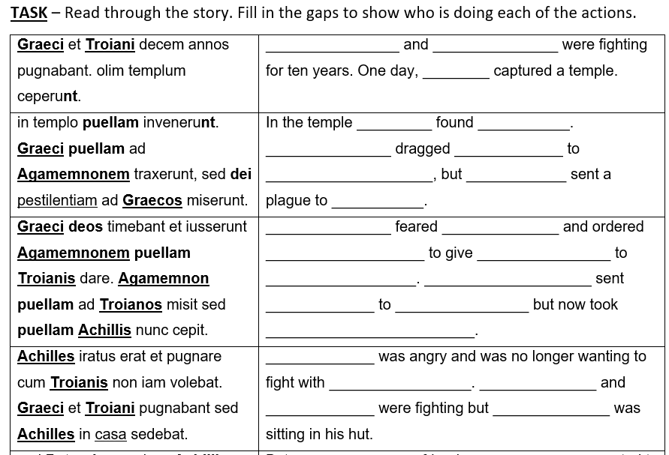

Slide 38
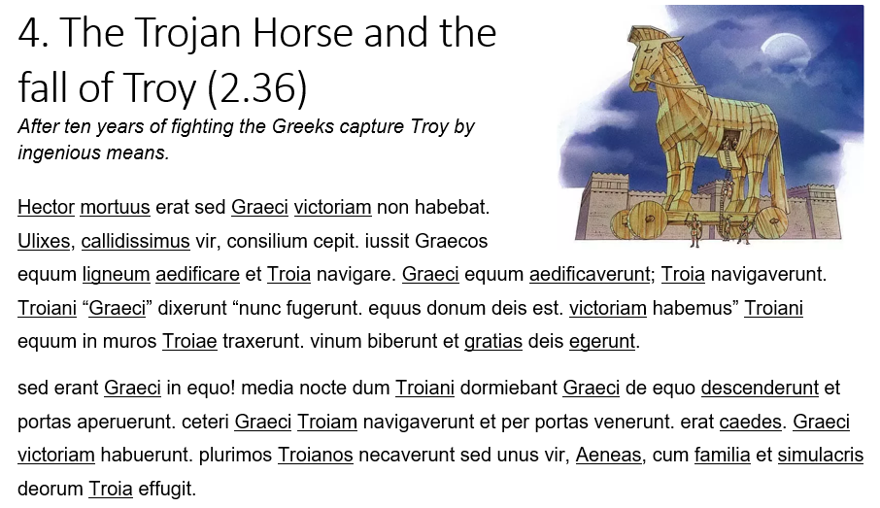
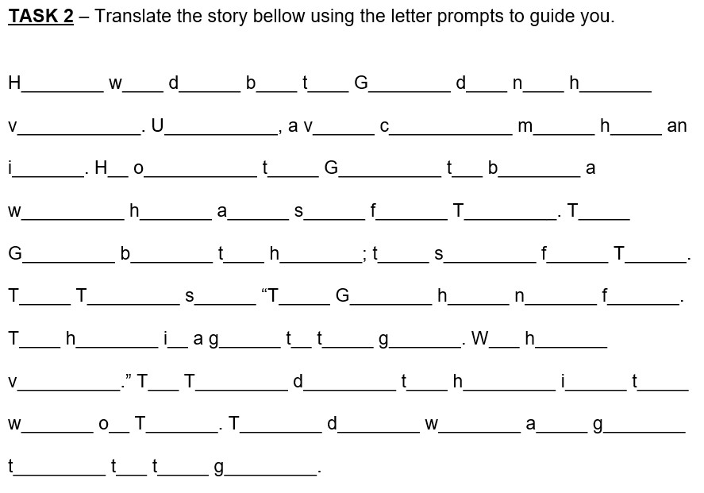

Slide 39
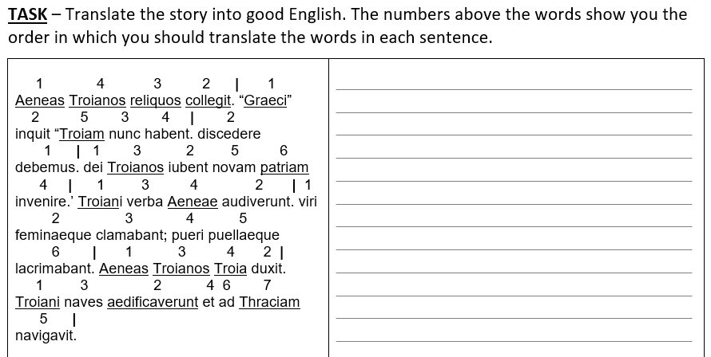

Slide 40
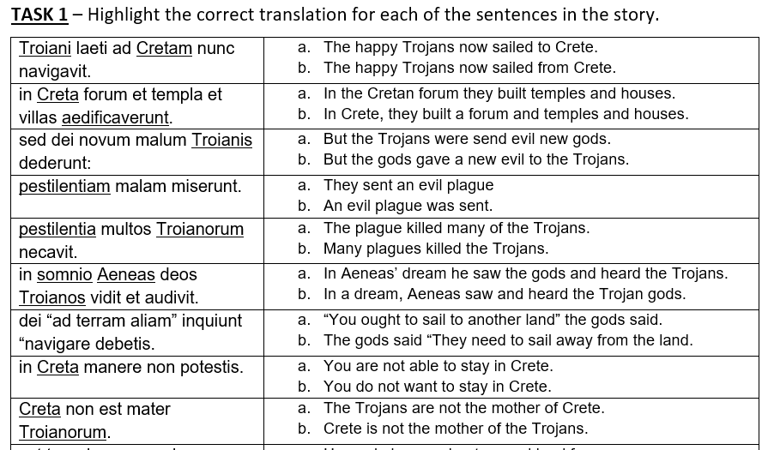

Slide 41







Porsena contrā Rōmānōs pugnāvit. Porsena multōs
Rōmānōs interfēcit. Porsena multās puellās cēpit.
Porsena laetus erat. ‘multōs Rōmānōs interfēcī,’ inquit,
‘et multās puellās cēpī. Rōmānōs terruī. rēx fortis sum.

Slide 42

Image Banks
Noun Project - https://thenounproject.com/
Flat Icon - https://www.flaticon.com/
Picturae Database - http://www.practomime.com/picturae/index.php/picturae-database
Emojipedia - https://emojipedia.org/

Slide 43
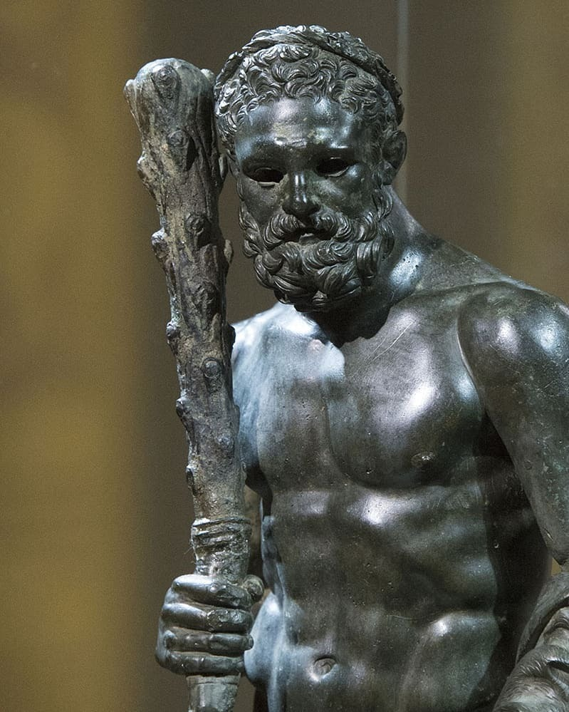
Don’t worry if your brain is feeling a bit frazzled after all of those noun and adjective endings!
REMEMBER - Adjectives are much easier in practice. Look again at the following sentence:
Hercules pulcher monstrum saevum vicit.
vicit = conquered/defeated
Which words are the adjectives? Which nouns do they agree with?
Adjectives are usually found after the nouns that they describe (except for adjectives describing size or quantity which usually go before).
Also you can tell which words are the adjectives by their meanings!

Slide 44
Step 1 - Do we know what each of the words in the sentence means?
Step 2 - From the meanings and positions of the words can we identify the noun adjective pair?
Step 3 - Can we accurately translate the sentence?
Horatius homines fortes interfecit.
Horatius (name)
men
brave
killed.
Horatius killed the brave men.

Slide 45
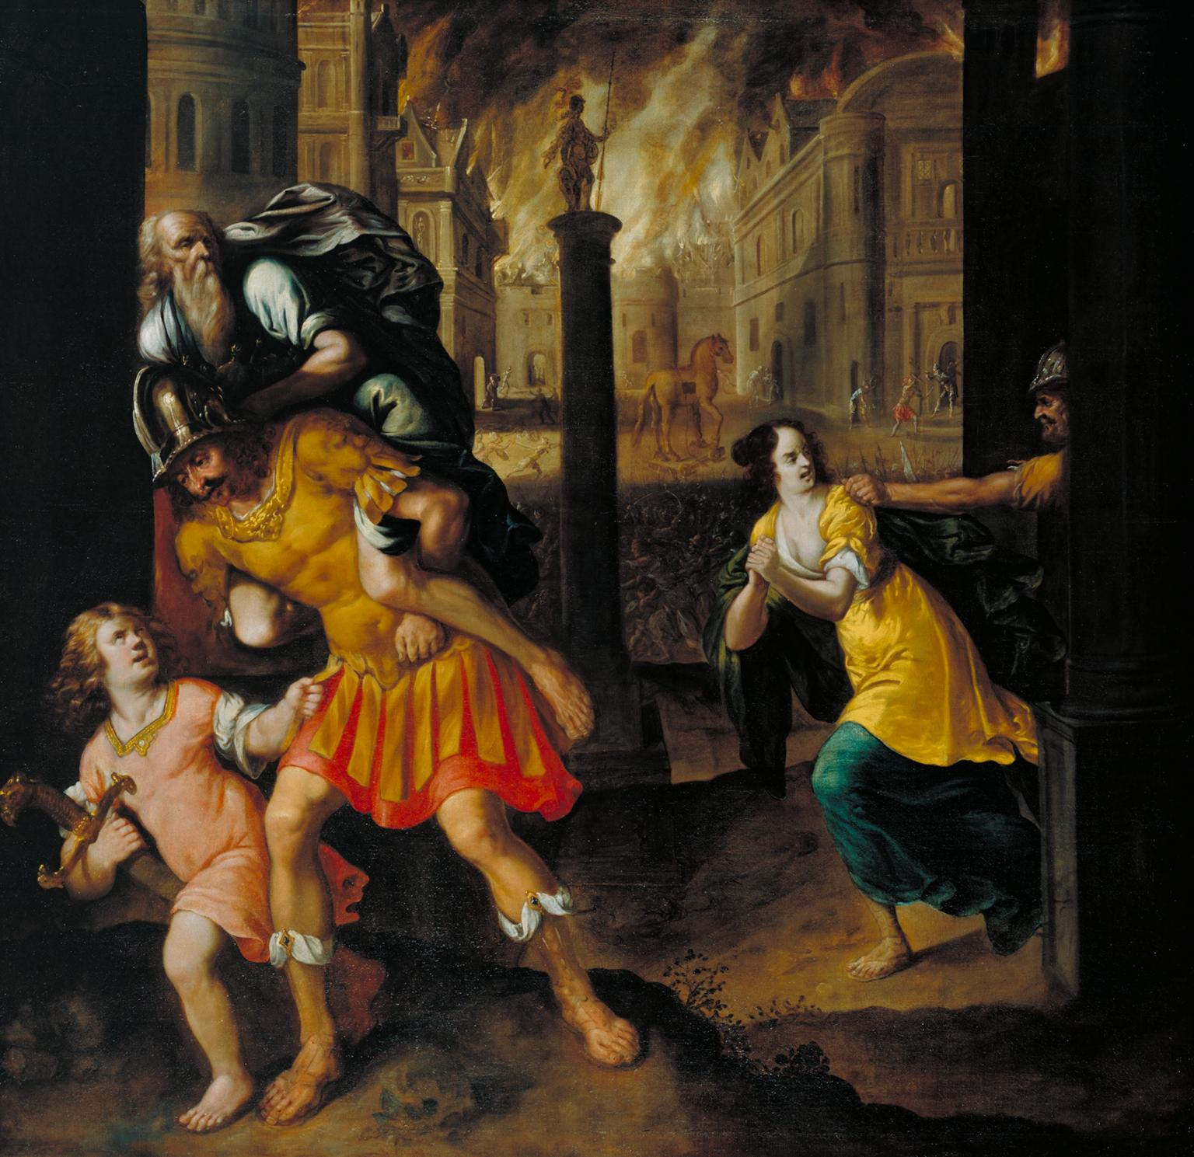
TASK: Label the image with the correct vocabulary.
Troia incendens
Penates
(sanctissimi)
Anchises
(pater)
equus ligneus
Creusa
(uxor)
Aeneas
(heros fortis)
multi Graeci
Ascanius
(filius)

Slide 46
What might our students with additional and varying needs find difficult about accessing challenging texts in translation?
Not having the background knowledge to access the text.
Dyslexia & ADHD – one huge chunk of text.
Differing and Varying Needs
Mixed attainment 9-1 classroom
SEND
(Special Educational Needs and Disabilities)
Low levels of literacy
EAL
(English as an Additional Language)
Old fashioned & idiomatic language
Not having the sufficient English vocabulary or grammar

Slide 47
Accessing challenging texts in translation
Read aloud
Pre-teach and explore difficult vocabulary (frayer model) – and return to these later to consolidate
Identify difficult vocabulary and support
  Word banks
  Rewordify - https://rewordify.com/
  Diffit - https://web.diffit.me/
  Images, artworks and diagrams (including family trees)
Question for understanding
Summarise the text – words and images
Highlight key words and phrases
Scaffolded note taking
Frequent retrieval activities (e.g. quizzes)
  Plot & characters
  Key vocabulary
Get pupils excited about the text.

Slide 48
Definition | Etymology (or characteristics/illustration)
Examples | Non-examples
Someone who worships or believes in more than one god.
Greek:
poly- = many + theos = god
Polytheist
The ancient Greeks, Romans and Egyptians were polytheists because they worshiped many gods.
Jews, Christians and Muslims are monotheists because they believe in one god.

Slide 49

TASK: Draw the scene being described and label with quotes from the text.
Challenge: What inferences can we make about Cacus from this text?
There was a cave here, receding to vast depths, untouched by the sun's rays, inhabited by the fell shape of Cacus, the half-human, and the ground was always warm with fresh blood, and the heads of men, insolently nailed to the doors, hung there pallid with sad decay. Vulcan was father to this monster: and, as he moved his massive bulk, he belched out his dark fires.
Vocabulary Support
receding moving back (or away)
vast huge
inhabited lived in
insolently disrespectfully and rudely
pallid pale
decay rotted, inferior, or ruined state
massive huge
belched noisily expelled air from the stomach
Notes:
Use https://rewordify.com/ to identify challenging vocabulary.

Slide 50
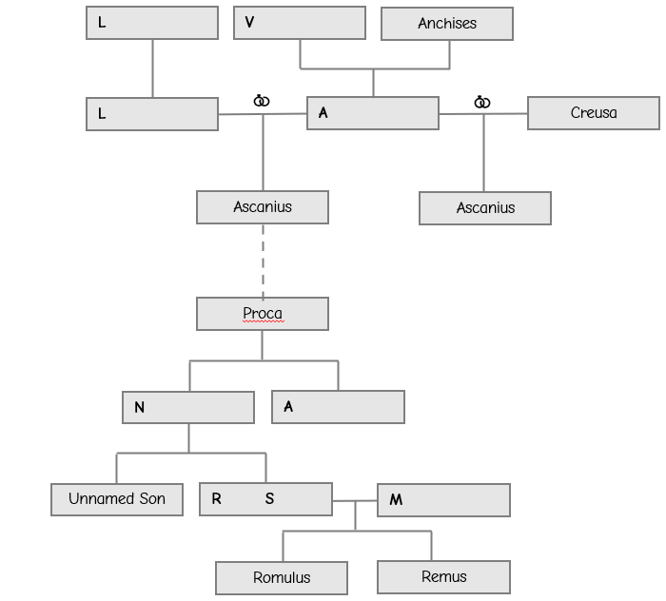

Slide 51
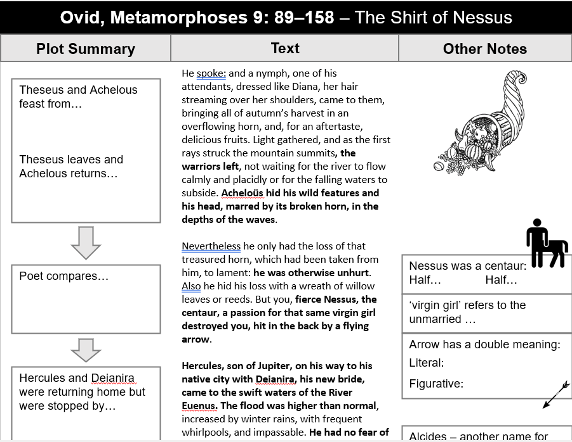

Slide 52
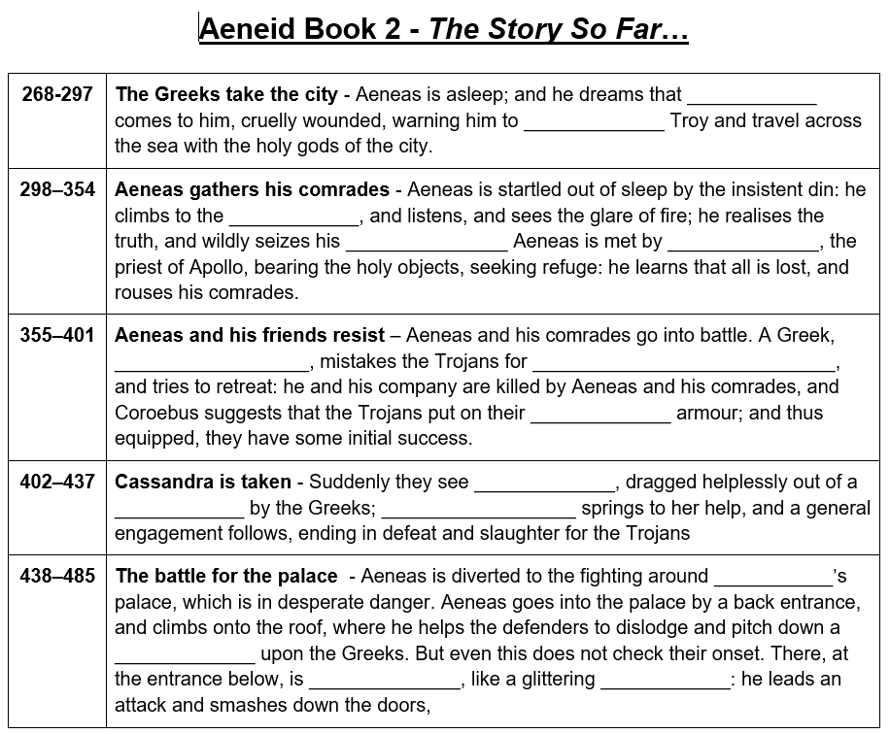
Further ways to adapt:
Provide a word bank
Provide the first letter of each word
Add or reduce number of gaps
Add images to support
Add challenge questions at the end to extend thinking e.g. How has Aeneas been portrayed by Virgil?

Slide 53
What might our students with additional and varying needs find difficult about essay writing?
Where do I start?
Different to what they have been told in English, History, RE etc.
Differing and Varying Needs
Mixed attainment 9-1 classroom
SEND
(Special Educational Needs and Disabilities)
Low levels of literacy
EAL
(English as an Additional Language)
Processing
Formal language and vocabulary
What is the question actually asking me to do?

Slide 54
Essay writing
Model success (but try to use a pupil exemplar if you can)
Explicitly show what makes a good answer – the mark scheme is not pupil friendly.
Give students vocabulary
Sentence starters
Structure strips
Discuss and debate before writing
Joint planning – narrate the process

Slide 55
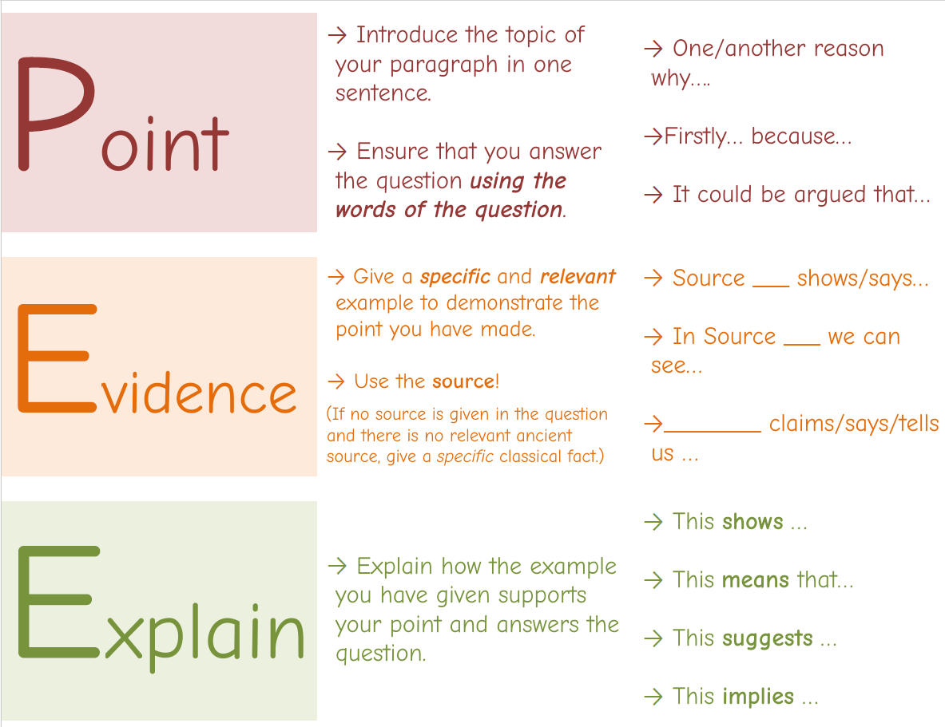

Slide 56
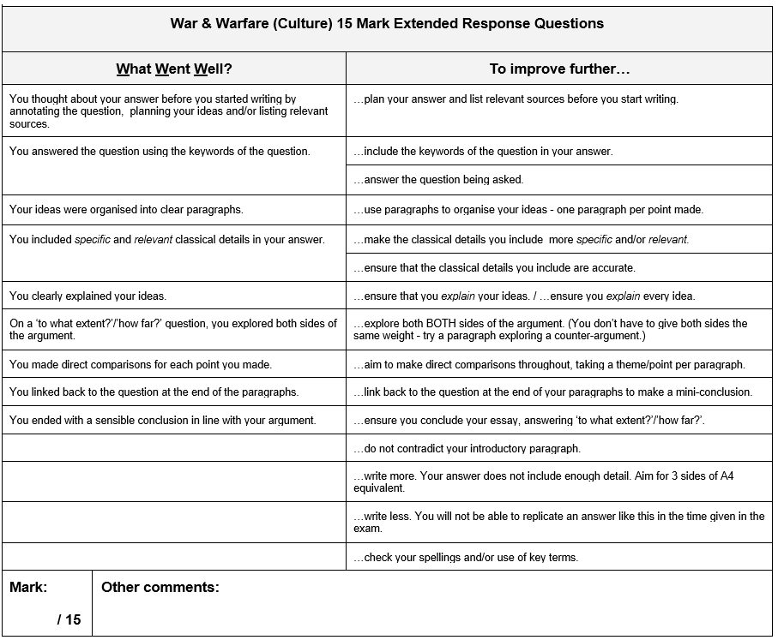

Slide 57
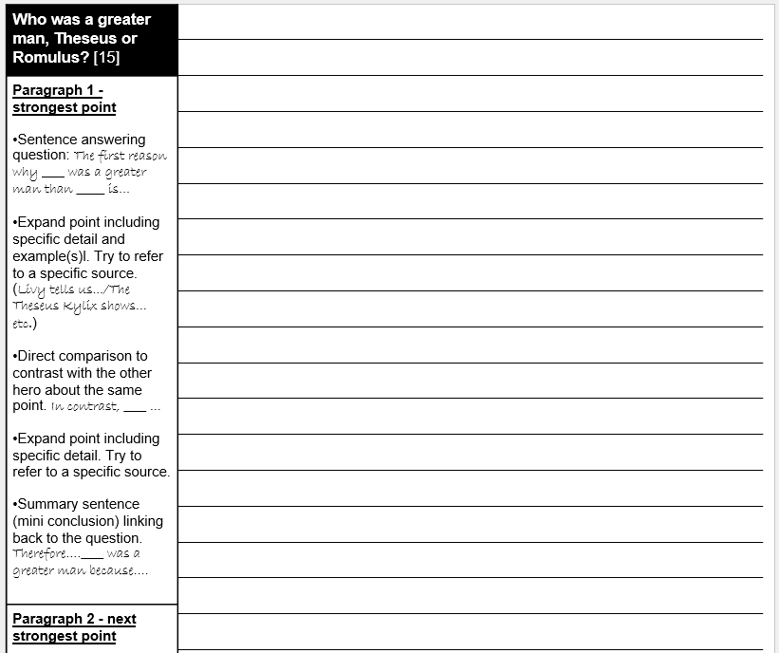

Slide 58
What might our students with additional and varying needs find difficult about literature in Latin/Greek?
Vocabulary and grammar is beyond requirements of GCSE Language
Access to the text
Differing and Varying Needs
Mixed attainment 9-1 classroom
SEND
(Special Educational Needs and Disabilities)
Low levels of literacy
EAL
(English as an Additional Language)
Motivation
Different to what they have been told in English
New complex terminology to grapple with – chiasmus, anaphora, asyndeton…

Slide 59
Literature in Latin/Greek
Don’t leave this skill until Y11 – introduce it into your KS3 curriculum (if you have one)
Pre-teach plot
Consider teaching in dual translation.
Comic strip of narratives
Get students excited about the text
Familiarisation → Analysis → Consolidation → Regular quizzing & feedback
  Familiarisation: identify people & places, GCSE vocabulary, match the translation to the lines, gap fills of key vocabulary
Identify ‘anchor words’
Prioritise & pick your battles
JCT Article by Coe & Hunt (2022) https://www.cambridge.org/core/journals/journal-of-classics-teaching/article/adaptive-teaching-for-gcse-and-a-level-classical-literature/0CE1C94B3B65F59E2AFFC4ACDEC5E3ED

Slide 60
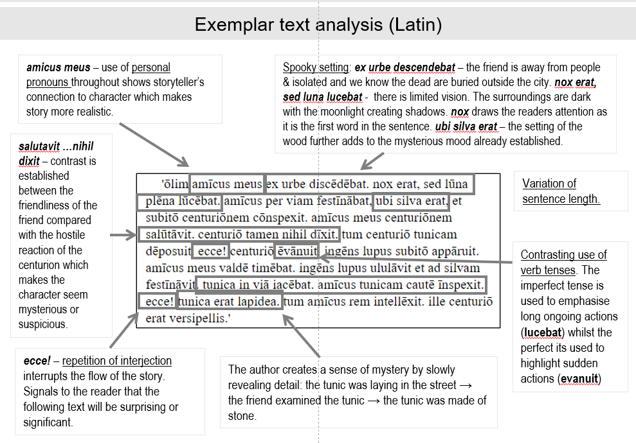

Slide 61
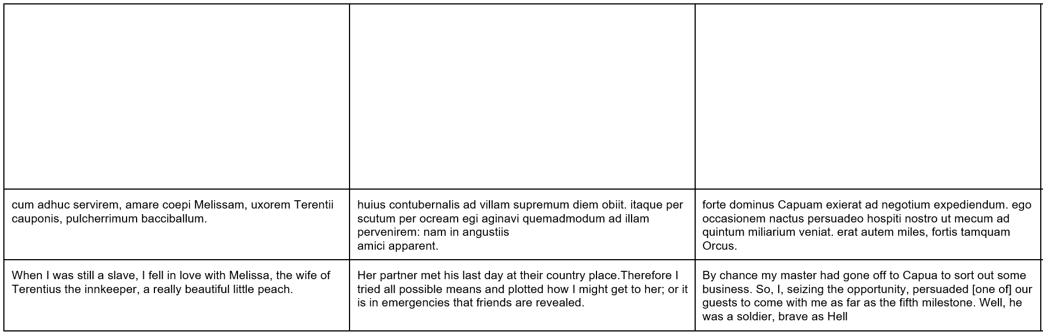

Slide 62
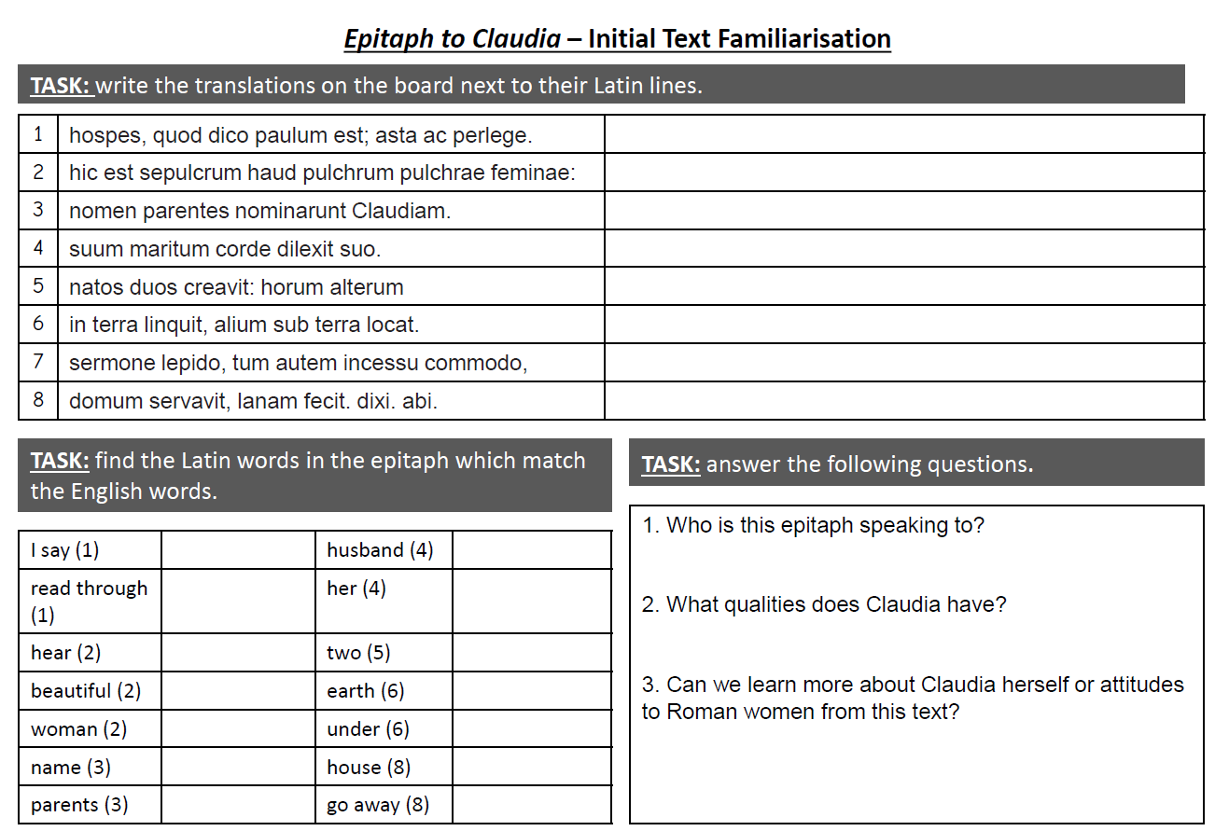

Slide 63
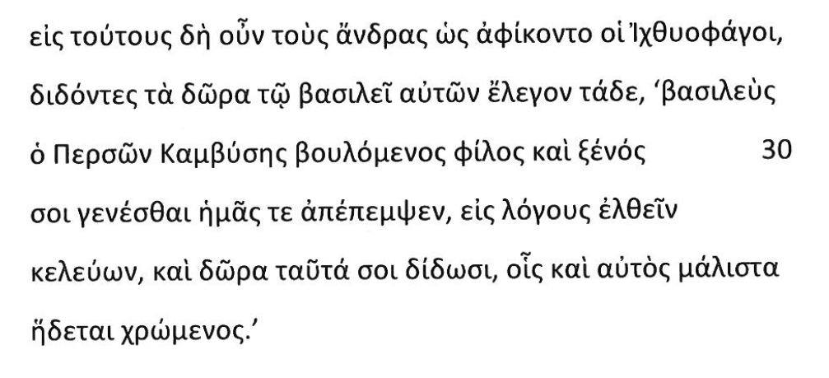
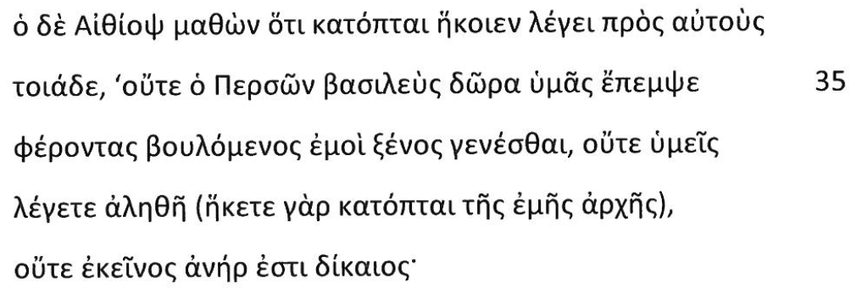
Names & Places
Line 28 – fish eaters
Line 30 – Persian, Cambyses
Line 34 – Ethiopian; as spies
Line 35 – of Persia
Line 37 as spies

Slide 64
Line 28: these; indeed; therefore; men; arrived
Line 29: the gifts; they said; these things
Line 30: wishes; friend; guest friend;
Line 31: to you; to be; us;
Line 32: ordering; gifts; these to you; he himself; very much
Line 33
Line 34: having learned; that; them
Line 35: neither; gifts; you; send
Line 36: carrying; my; guest-friend; to be; nor; you;
Line 37: speak; the truth; my;
Line 38: nor; that; man; is; just
GCSE Vocabulary

Slide 65
TASK 1: Match the Greek to the English translation.
λαβὼν δὲ τὸ εἷμα τὸ πορφυροῦν
ἤρετο ὅ τι εἴη καὶ ὅπως πεποιημένον·
εἰπόντων δὲ τῶν Ἰχθυοφάγων τὴν ἀλήθειαν
περὶ τῆς πορφύρας καὶ τῆς βαφῆς,
δολεροὺς μὲν τοὺς ἀνθρώπους ἔφη εἶναι,
δολερὰ δὲ αὐτῶν τὰ εἵματα.
δεύτερον δὲ περὶ τοῦ χρυσοῦ περιαυχενίου ἤρετο
καὶ περὶ τῶν ψελίων·
ἐξηγουμένων δὲ τῶν Ἰχθυοφάγων,
γελάσας ὁ βασιλεὺς
καὶ νομίσας αὐτὰ εἶναι πέδας
εἶπεν ὡς παρʹ ἑαυτοῖς εἰσι ῥωμαλεώτεραι τούτων πέδαι.
τρίτον δὲ ἤρετο περὶ τοῦ μύρου·
εἰπόντων δὲ αὐτῶν περὶ τῆς ποιήσεως καὶ ἀλείψεως,
τὸν αὐτὸν λόγον ὃν καὶ περὶ τοῦ εἵματος εἶπεν.
Secondly, he asked about the gold necklace
But when the Fish-Eaters told him the truth
When the Fish-Eaters explained,
he said that the men were deceitful
and their clothing was deceitful.
Thirdly, he asked about the perfume.
Having taken the purple clothing,
the king laughed
and thought that they were chains
he asked what it was and how it has been made.
he said the same remark that he’d also said about the clothing.
and said that there were stronger chains amongst his own people than these.
about the purple and the dying process,
And when they spoke about its manufacture and its use,
and the bracelets.

Slide 66

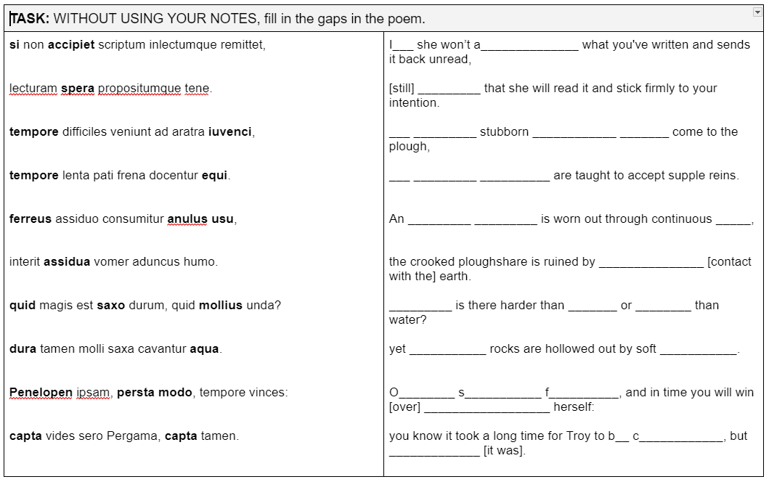
14th December
Ovid - Advice to a Rejected Lover
Lesson Objective(s): To analyse the poetry of Ovid
TASKS:
Write the date in your book (no need to write a new title, we are continuing from last time).
WITHOUT USING YOUR NOTES, fill in the gaps in the poem.
Support: If you have done as much as you can do without your notes, use your notes to help you complete the rest.
Challenge: Can you match any of the other Latin words to their translations?
Extreme: Annotate your gap fill with any stylistic points you can remember.

Slide 67

If
accept
hope
In time
young bulls
In time
iron
ring
use
LO: To analyse the poetry of Ovid
continuous
What
rock
softer
hard
water
Only stand firm
Penelope
be captured
captured

Slide 68
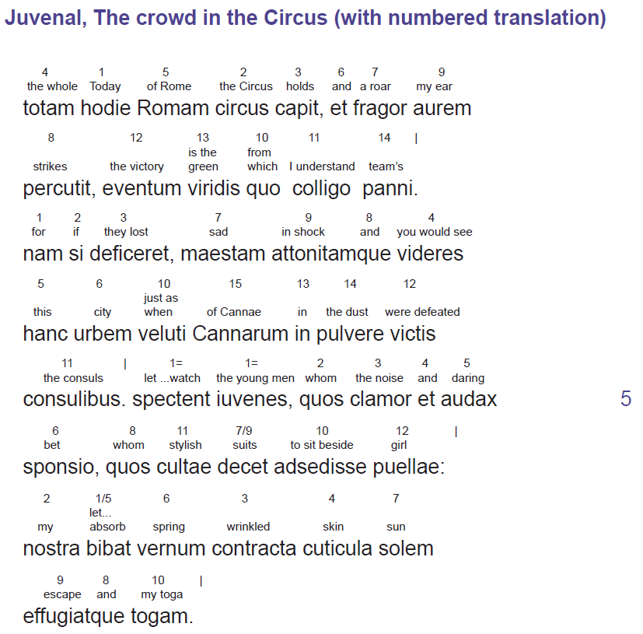
Previous CSCP Eduqas teacher’s notes

Slide 69
What might our students with additional and varying needs find difficult about English to Latin/Greek?
Cognitive overload
Differing and Varying Needs
Mixed attainment 9-1 classroom
SEND
(Special Educational Needs and Disabilities)
Low levels of literacy
EAL
(English as an Additional Language)

Slide 70
English to Latin/Greek
Don’t say it is ‘difficult’
  Normalise English to Latin and give opportunities to practice
Stems of words (conjugations)
  Give students stems
  Multiple choice
  Allow grammar table supports
Vocabulary
  Give students the vocabulary
Use image prompts

Slide 71
TASK: Put the correct endings onto the Latin words to translate the sentences from English into Latin.
 | English Sentence | Latin Translation
I | They praise the Romans. | Roman__ __ laud__ __ __.
II | He entered the garden. | hort__ __ intr__ __ __ __.
III | The master is waiting for the angry slave-girl. | domin__ __ ancill__ __ irat__ __ exspect__ __.
IV | Many children walked through the forum. | mult__ liber__ per for__ __ ambul__ __ __ __.
V | The women are relating a long story. | femin__ __ fabul__ __ long__ __ narr__ __.
Notes:
Challenge - don’t specify amount of letters

Slide 72
TASK: Select the correct endings for the Latin words to translate the sentences from English into Latin.
 | English Sentence | Latin Translation
I | They praise the Romans. | Roman( -i -os -um) laud( -at -ant -o).
II | He entered the garden. | hort( -us -um -o) intr( -at -abat -avit).
III | The master is waiting for the angry slave-girl. | domin( -os -i -um) ancill( -am -a -as) irat( -am -a -as) exspect( -at -abat -avit).
IV | Many children walked through the forum. | mult( -i -os -um) liber( -i -os -um) per for( -us -um -o) ambul( -at -abat -avit).
V | The women are relating a long story. | femin( -am -a -ae) fabul( -am -a -as) long( -am -a -as) narr( -at -abat -avit).
Notes:
Challenge - don’t specify amount of letters

Slide 73
TASK: Use the sentence builder to write 3 Latin sentences
Nominative |  | Accusative |  | Verb
Noun | Adjective | Noun | Adjective
deus - god filius - son homo - man pater - father rex - king | iratus - angry laetus - happy pulcher - handsome Romanus - Roman saevus - savage | deum - god filium - son hominem - man patrem - father regem - king | iratum - angry laetum - happy pulchrum - handsome Romanum - Roman saevum - savage | amavit - loved laudavit - praised punivit - punished terruit - terrified
dea - goddess filia - daughter femina - woman mater - mother regina - queen uxor - wife | irata - angry laeta - happy pulchra - beautiful Romana - Roman saeva - savage | deam - goddess filiam - daughter feminam - woman matrem - mother reginam - queen uxorem - wife | iratam - angry laetam - happy pulchram - beautiful Romanam - Roman saevam - savage

Slide 74
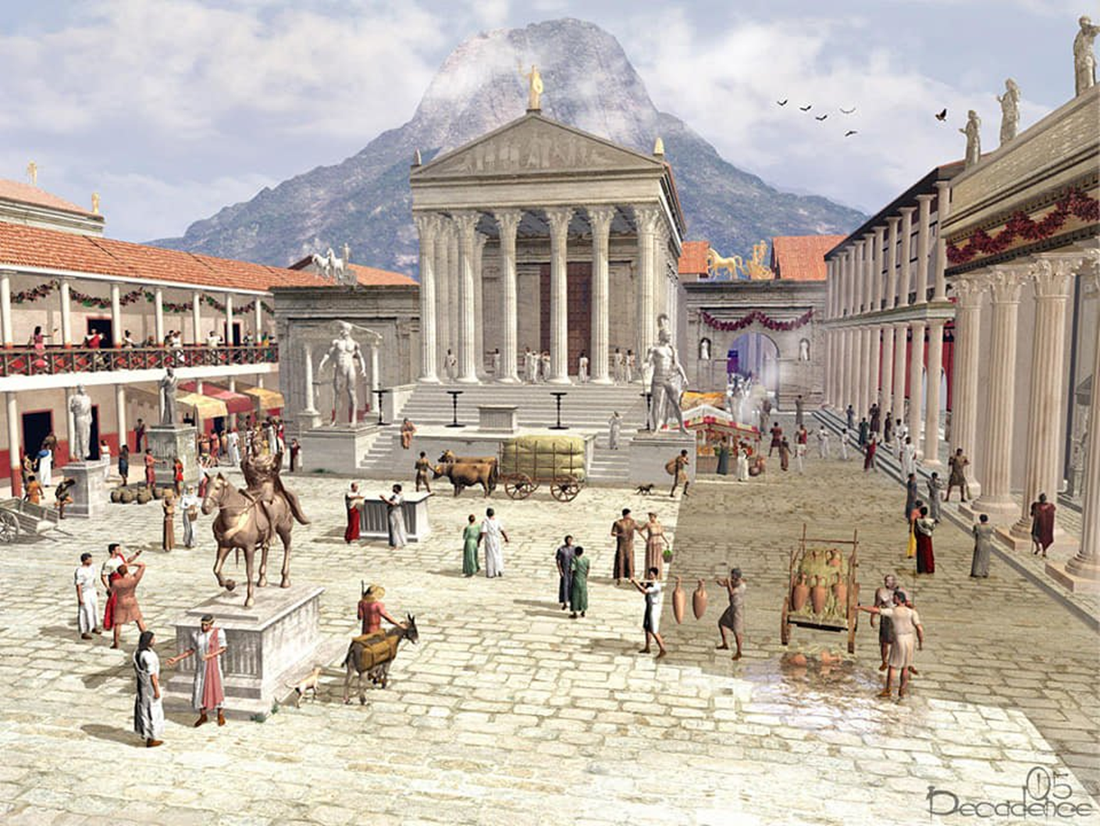
TASK: Write at least 3 sentences in Latin about this image.
in pictura est… [nom s.]
in pictura sunt… [nom pl.]
in pictura, …[nom (acc) verb]
in pictura [acc s/pl] video.
hic est… [nom m. s.]
haec est… [nom f. s.]
VOCABULA
templum
mons
statua
amphora

Slide 75
What might our students with additional and varying needs find difficult about Greek?
Differing and Varying Needs
Mixed attainment 9-1 classroom
SEND
(Special Educational Needs and Disabilities)
Low levels of literacy
EAL
(English as an Additional Language)
New alphabet
Strength: new to everyone at the same time

Slide 76
Greek
Spend time on handwriting
Speak aloud and think about phonics
Don’t rely on “you did this in Latin”

